Slide 1
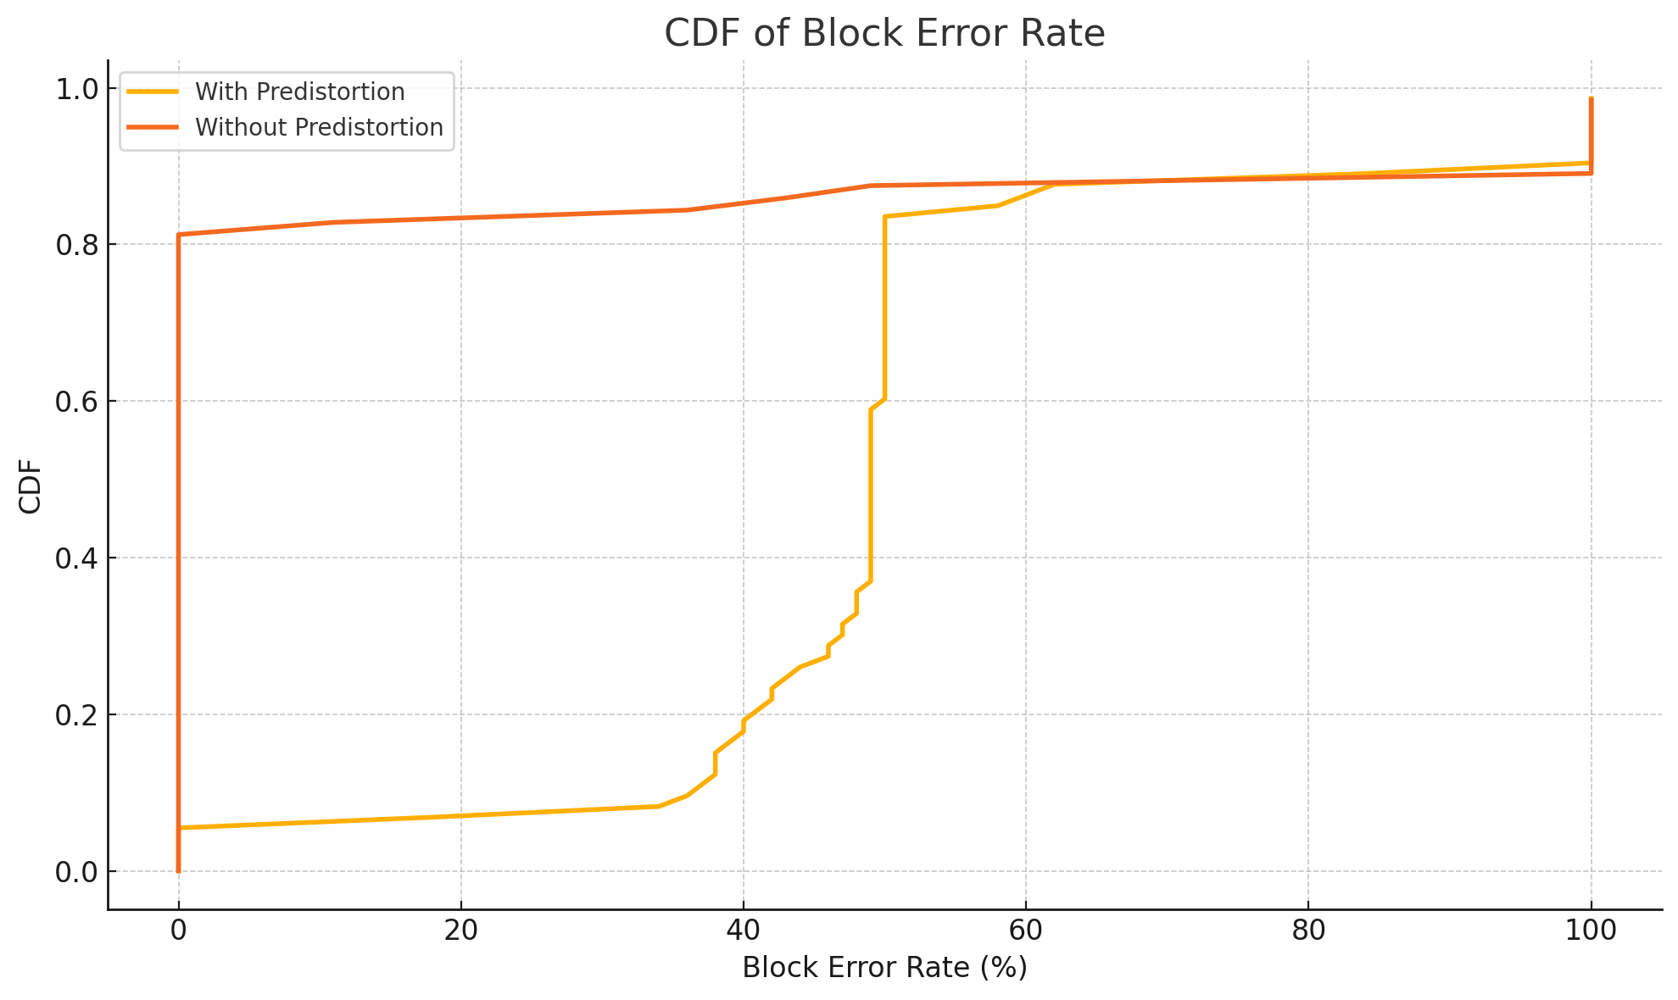
Fixed MCS=15

Slide 2
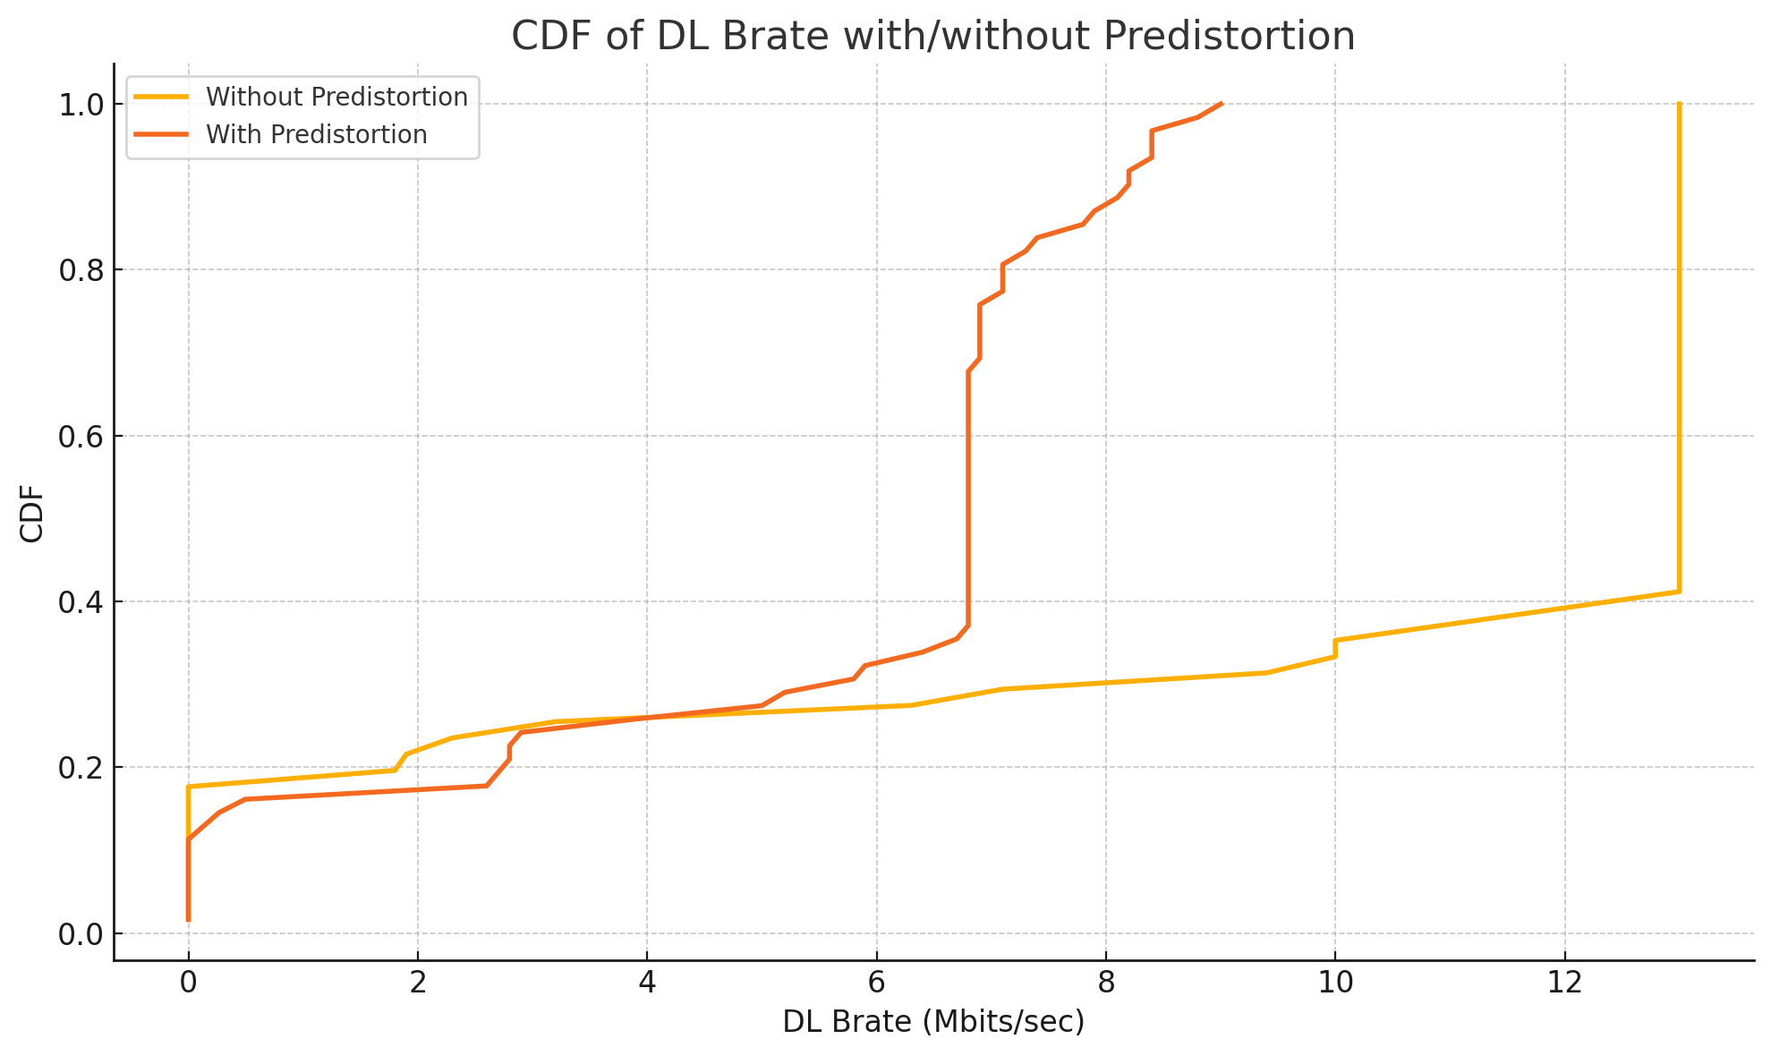

Slide 3
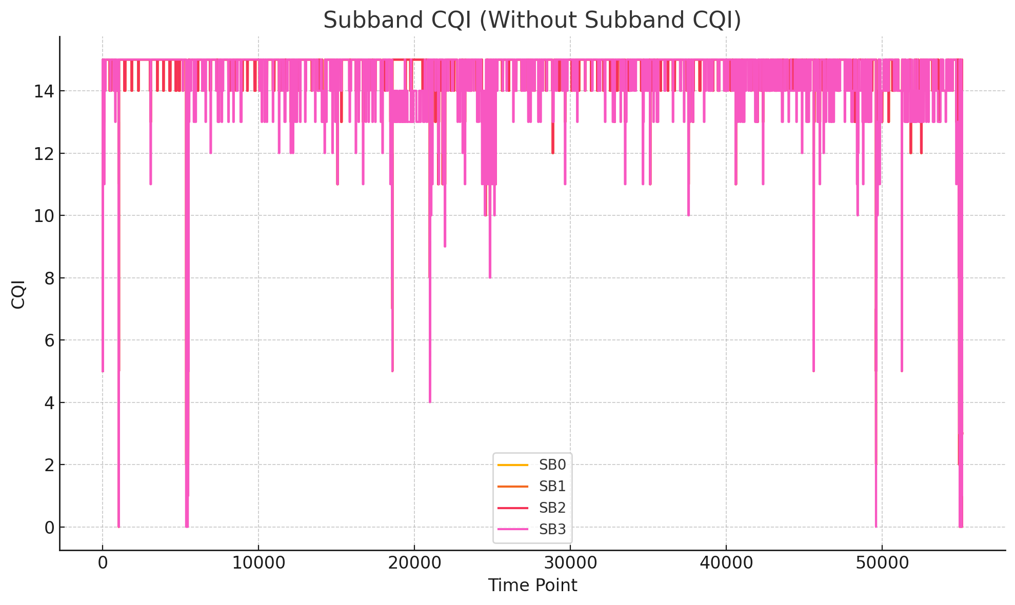
Without Predistortion

Slide 4
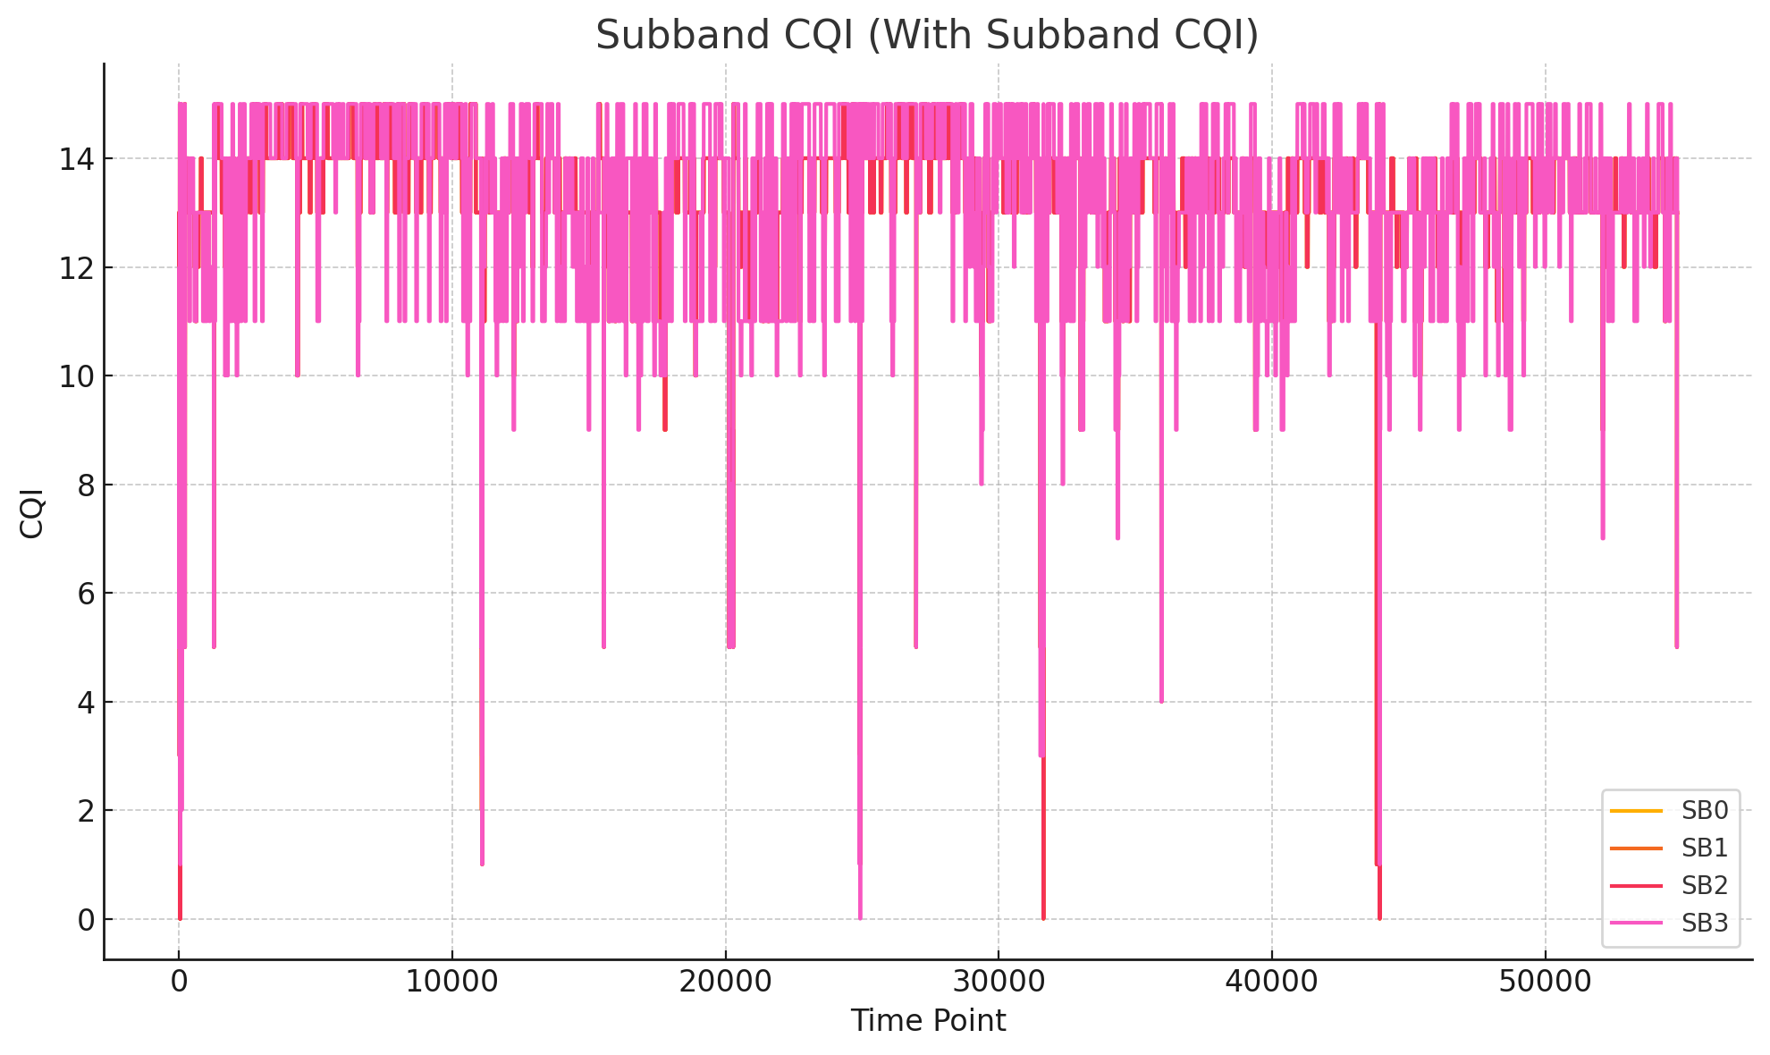
With Predistortion

Slide 5
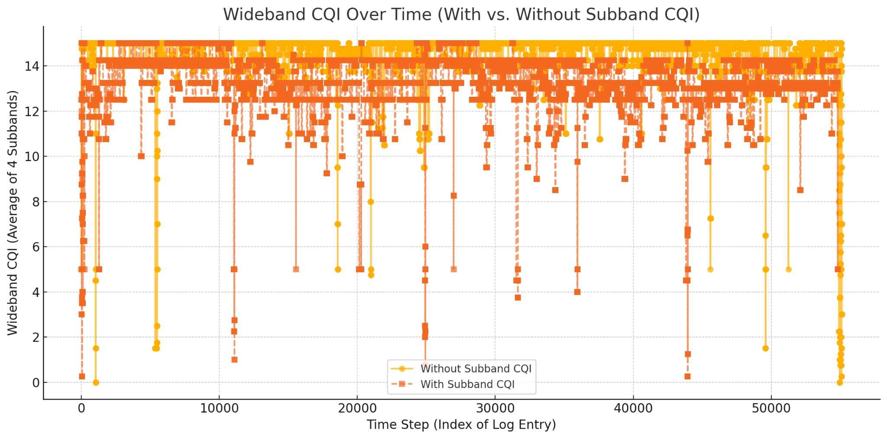

Slide 6
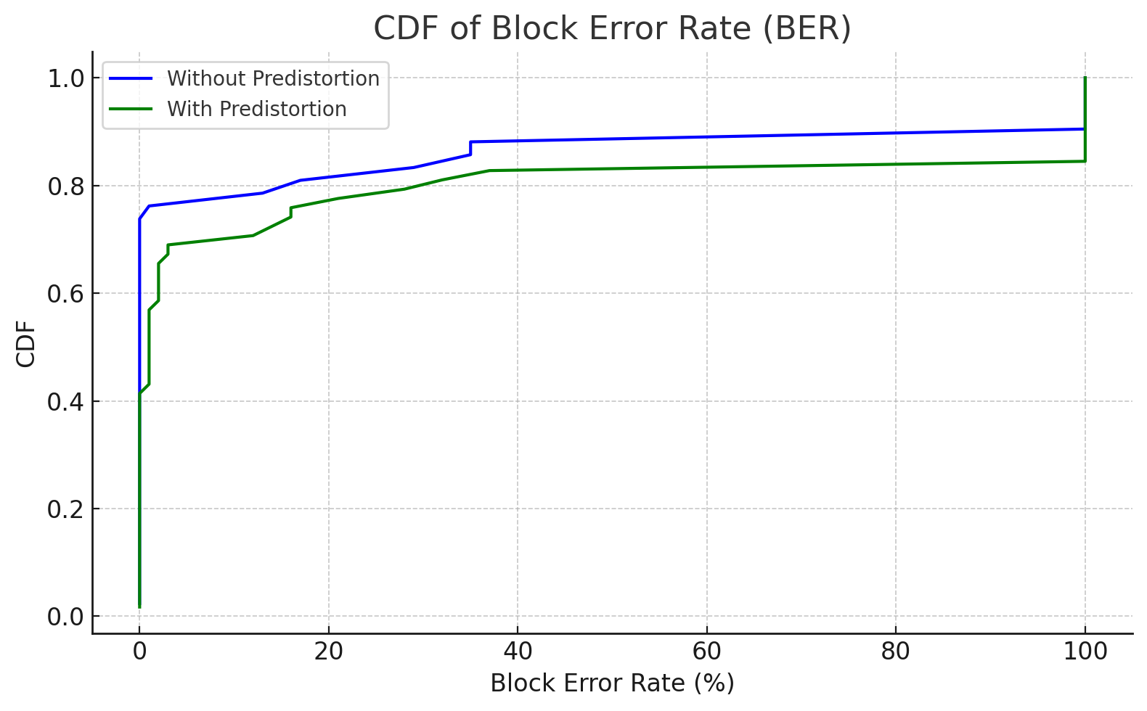
Fixed MCS=10

Slide 7
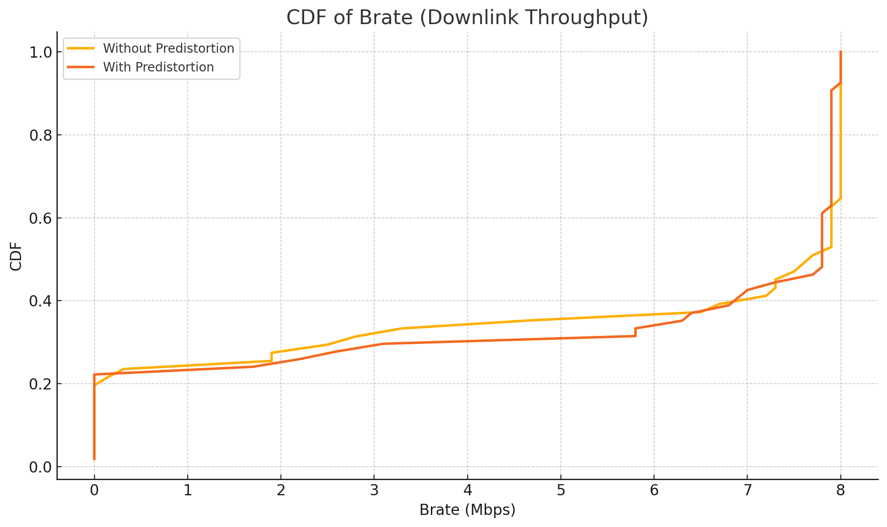

Slide 8
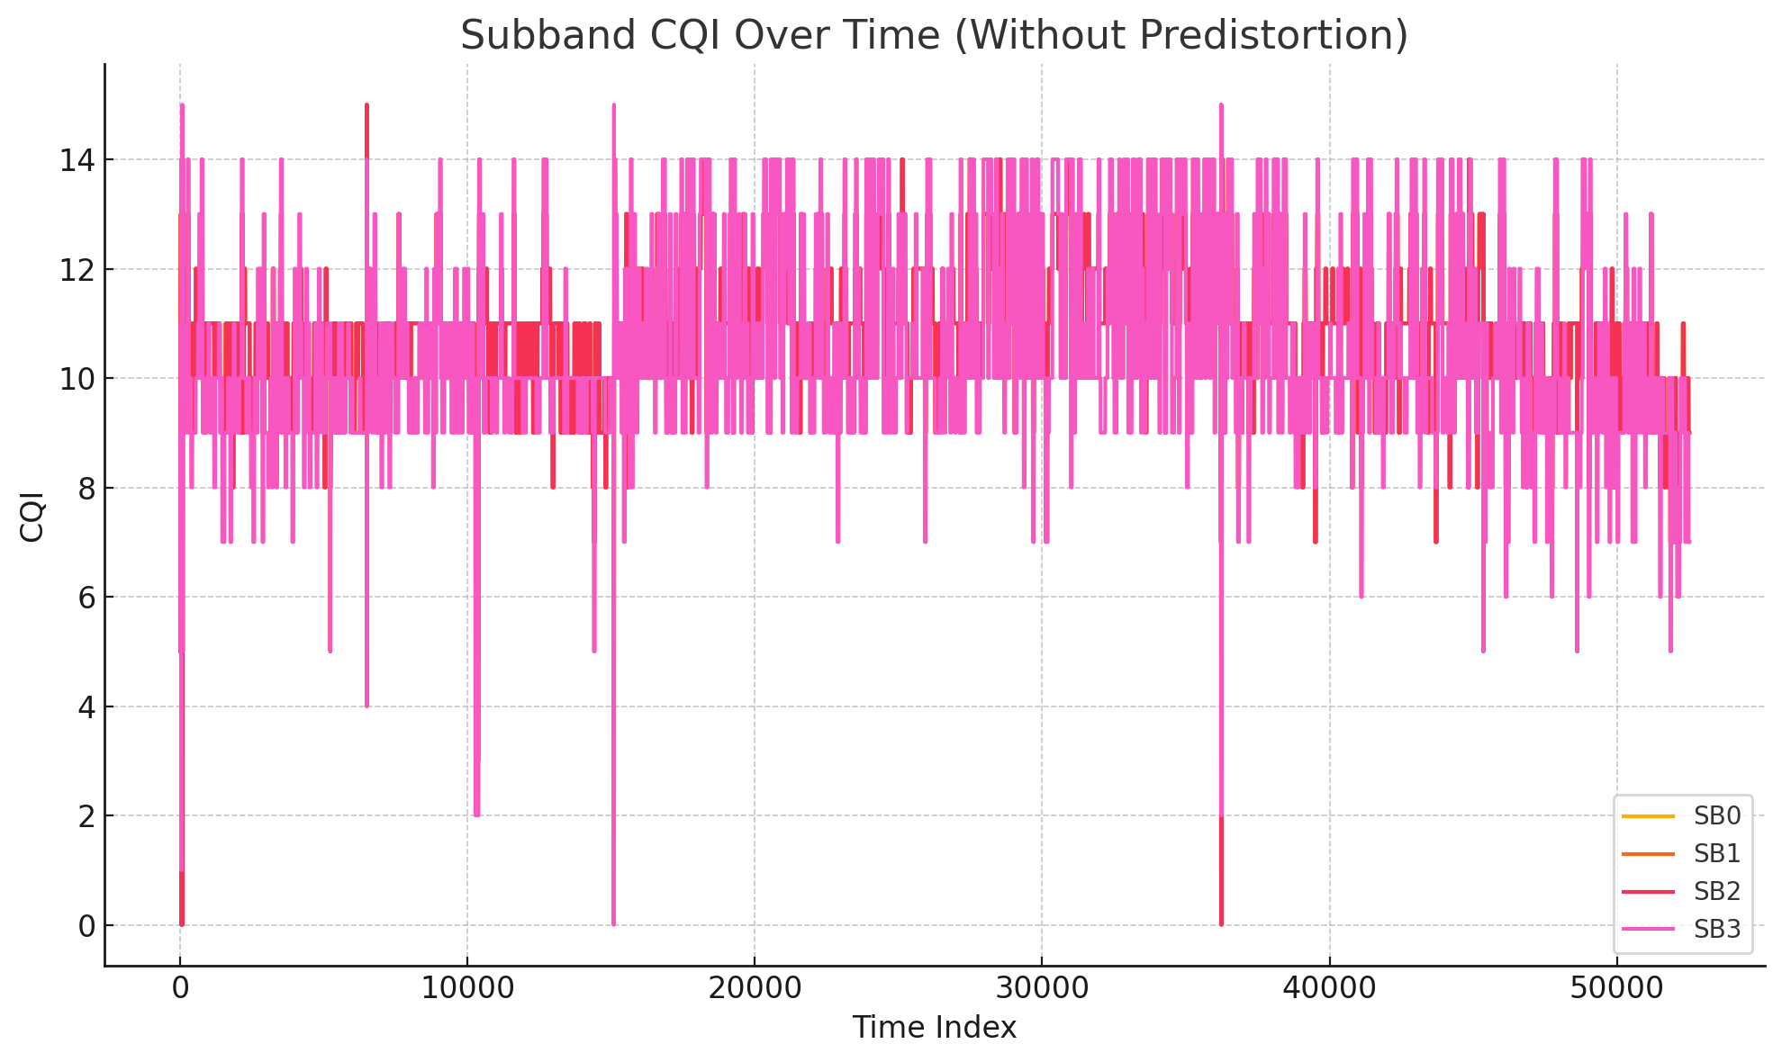

Slide 9
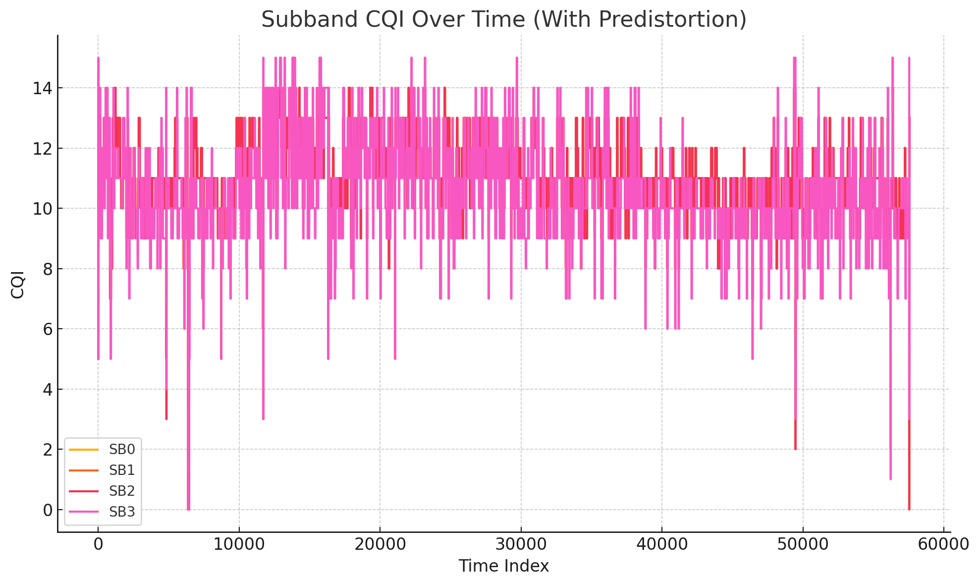

Slide 10
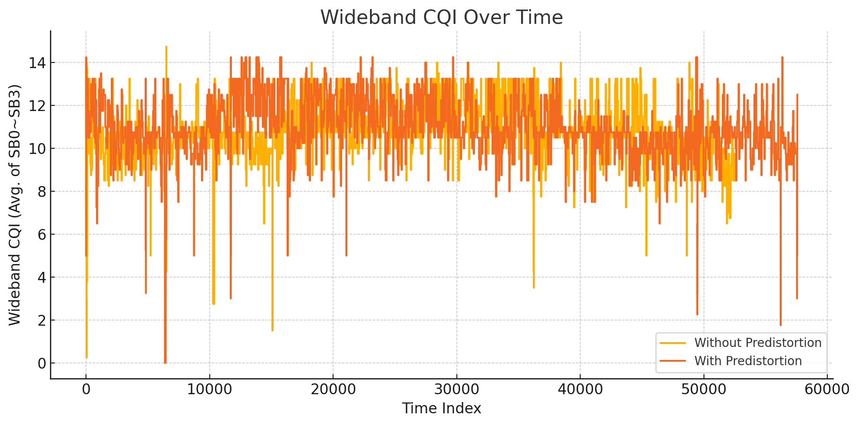

Slide 11
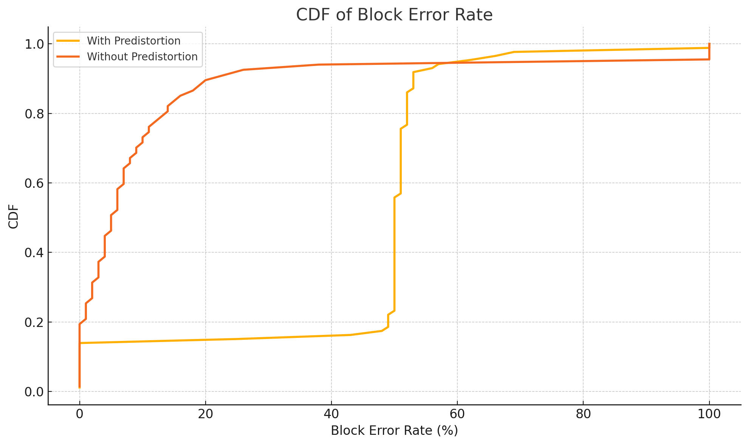
Fixed MCS=20

Slide 12
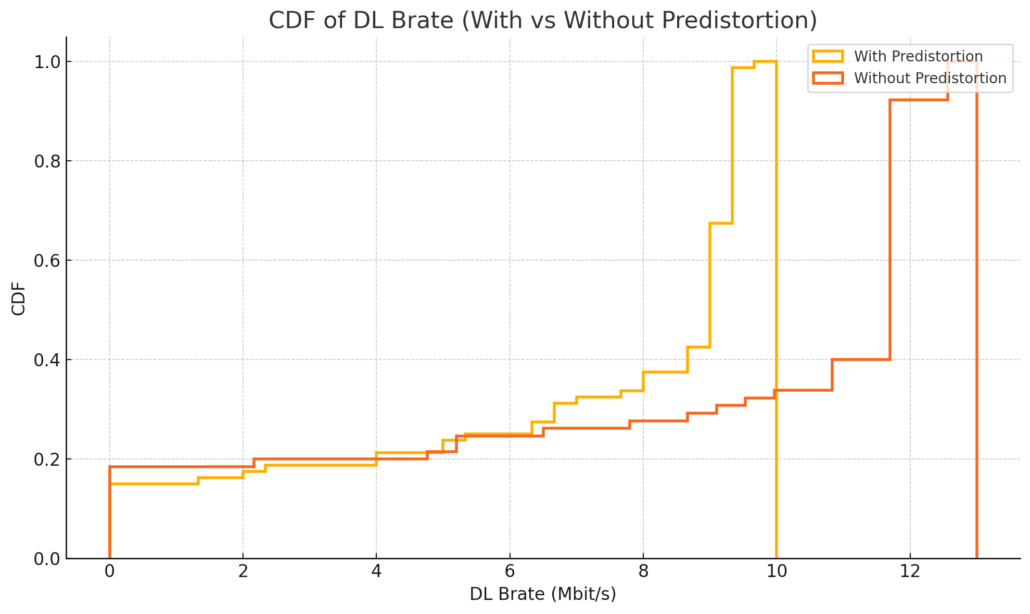

Slide 13
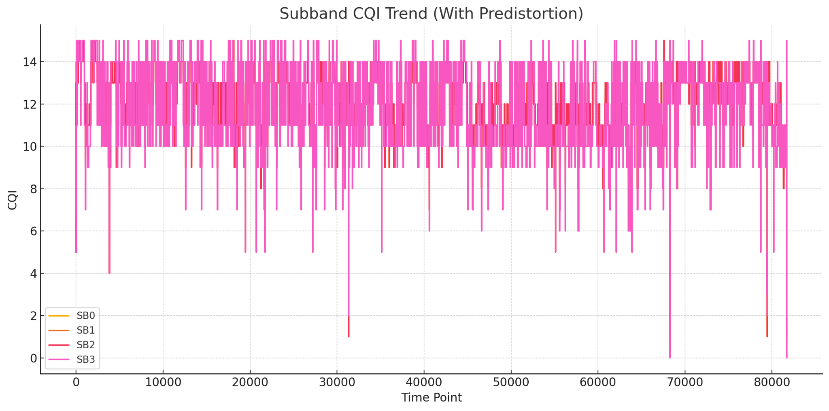

Slide 14
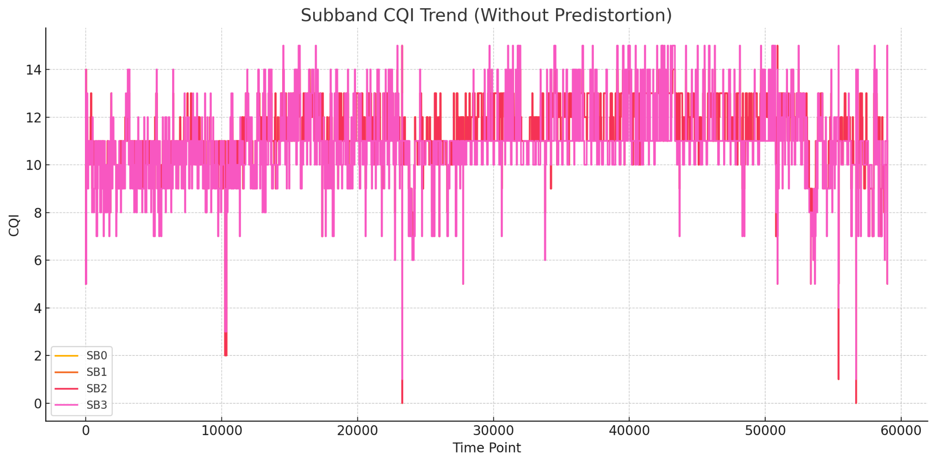

Slide 15
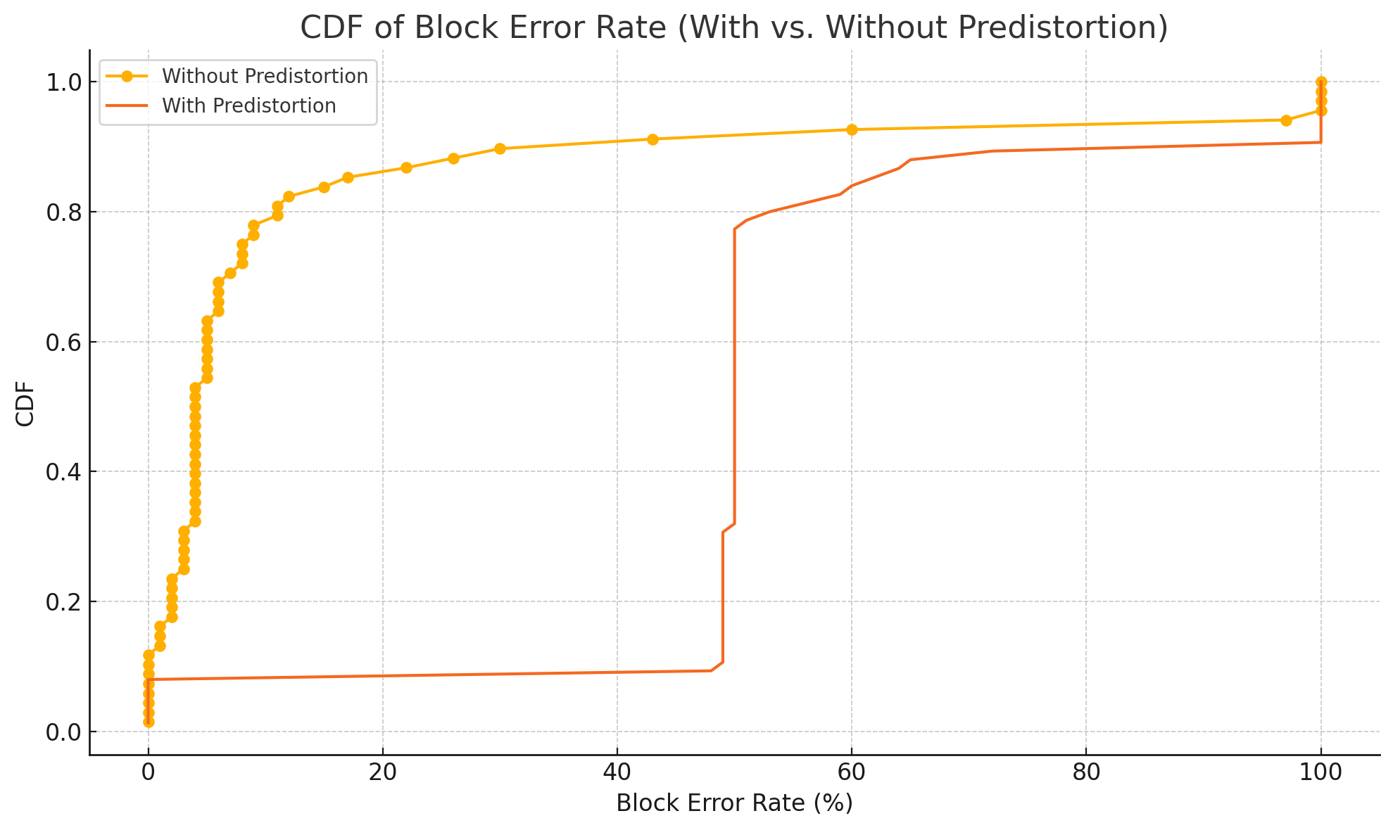
Move devices further from each other - Fixed MCS=15

Slide 16
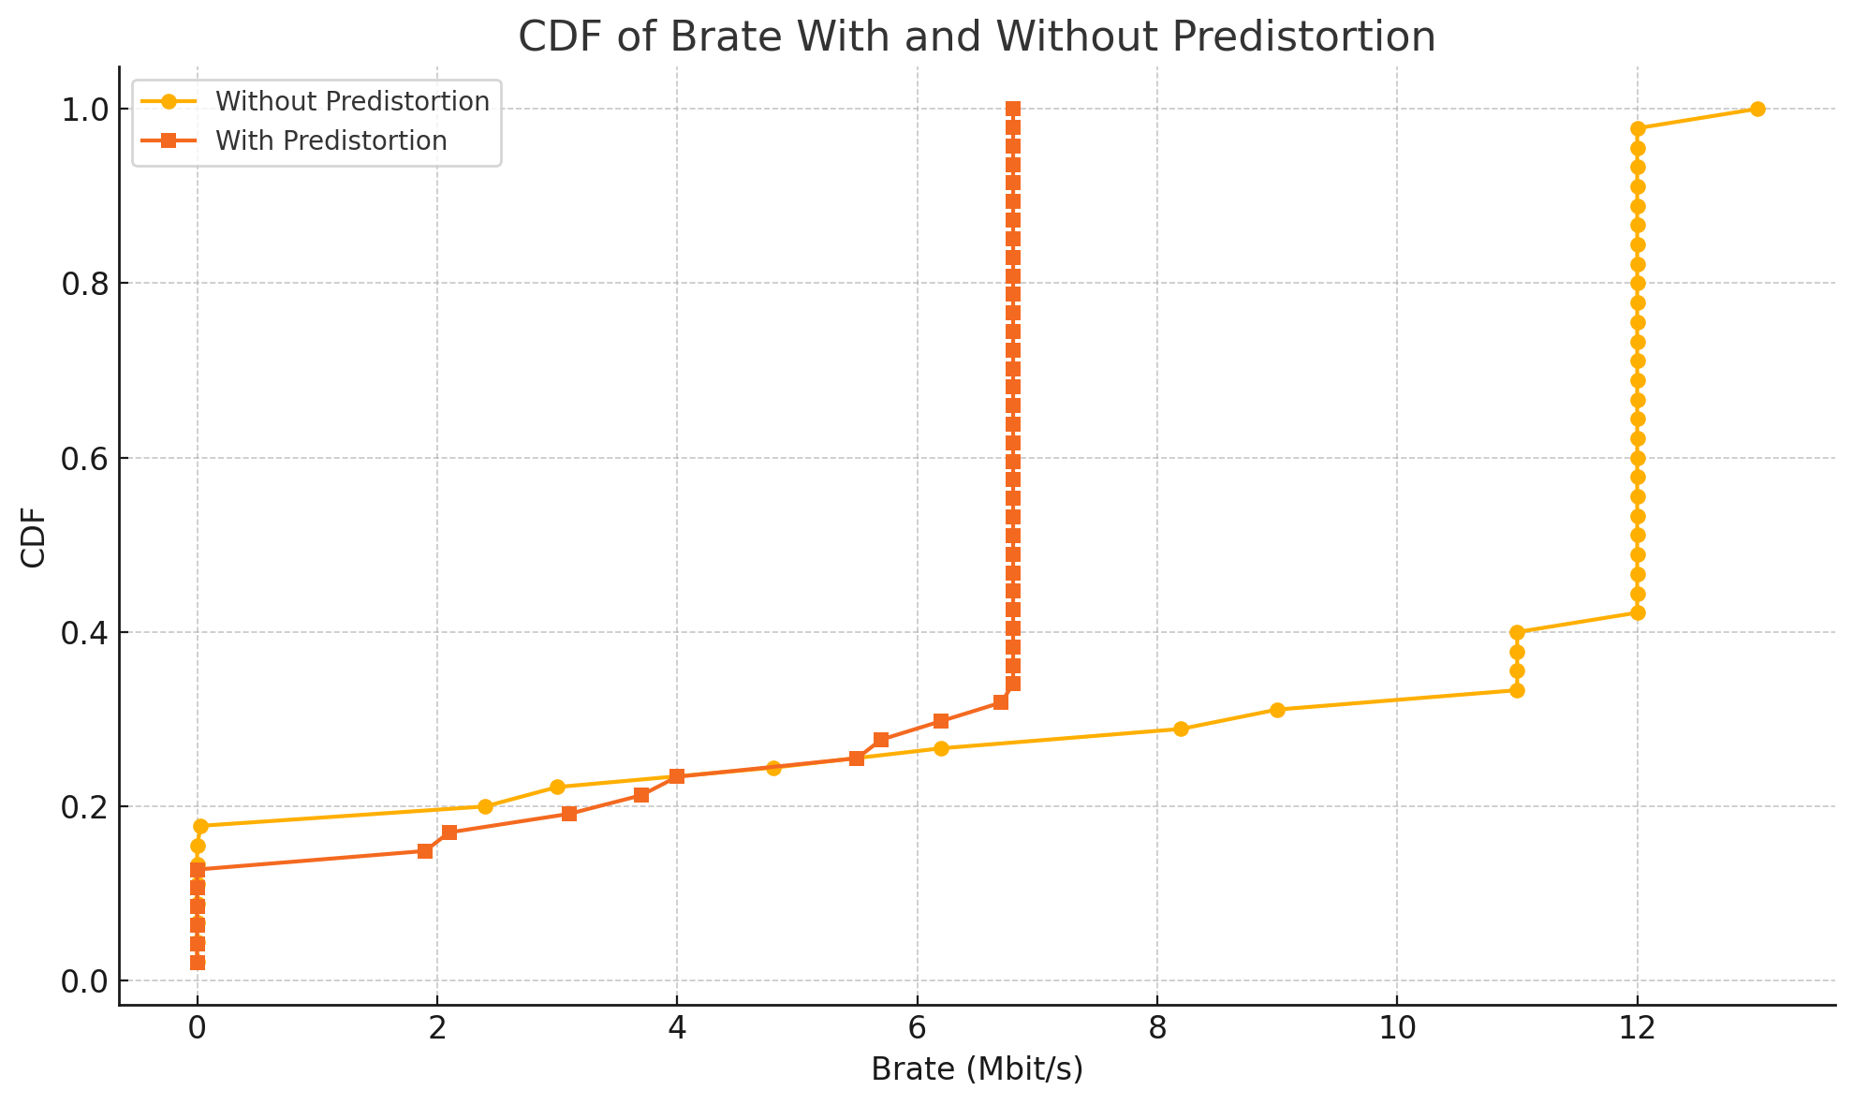

Slide 17
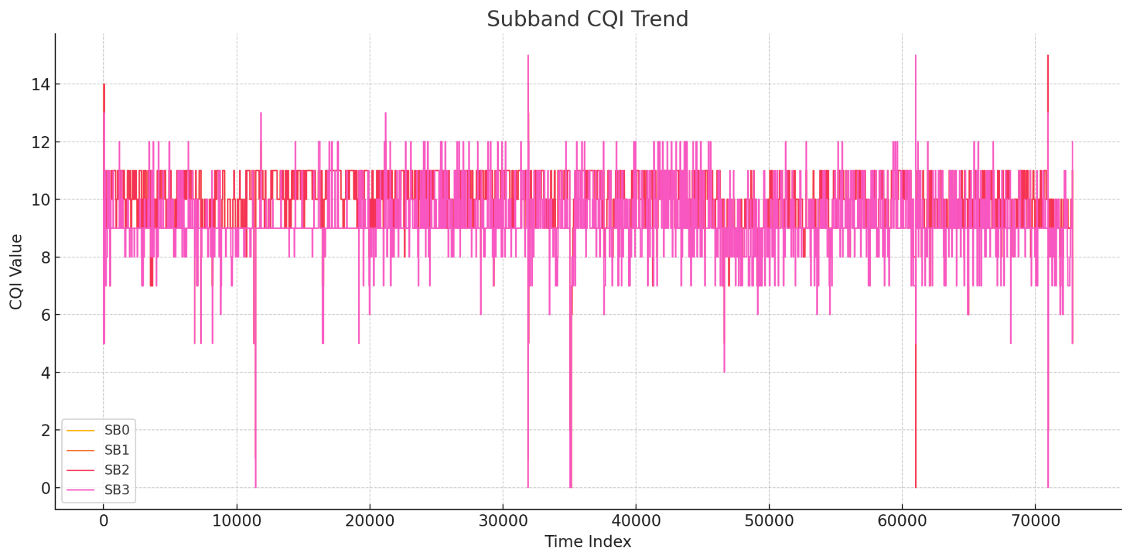

Slide 18
06/13/2025
To do:
try ramdisk to save CQI data
Separate 2 tests by looking at the trace info only and saving subband CQI only
Check the accuracy of subband CQI measurement

Slide 19
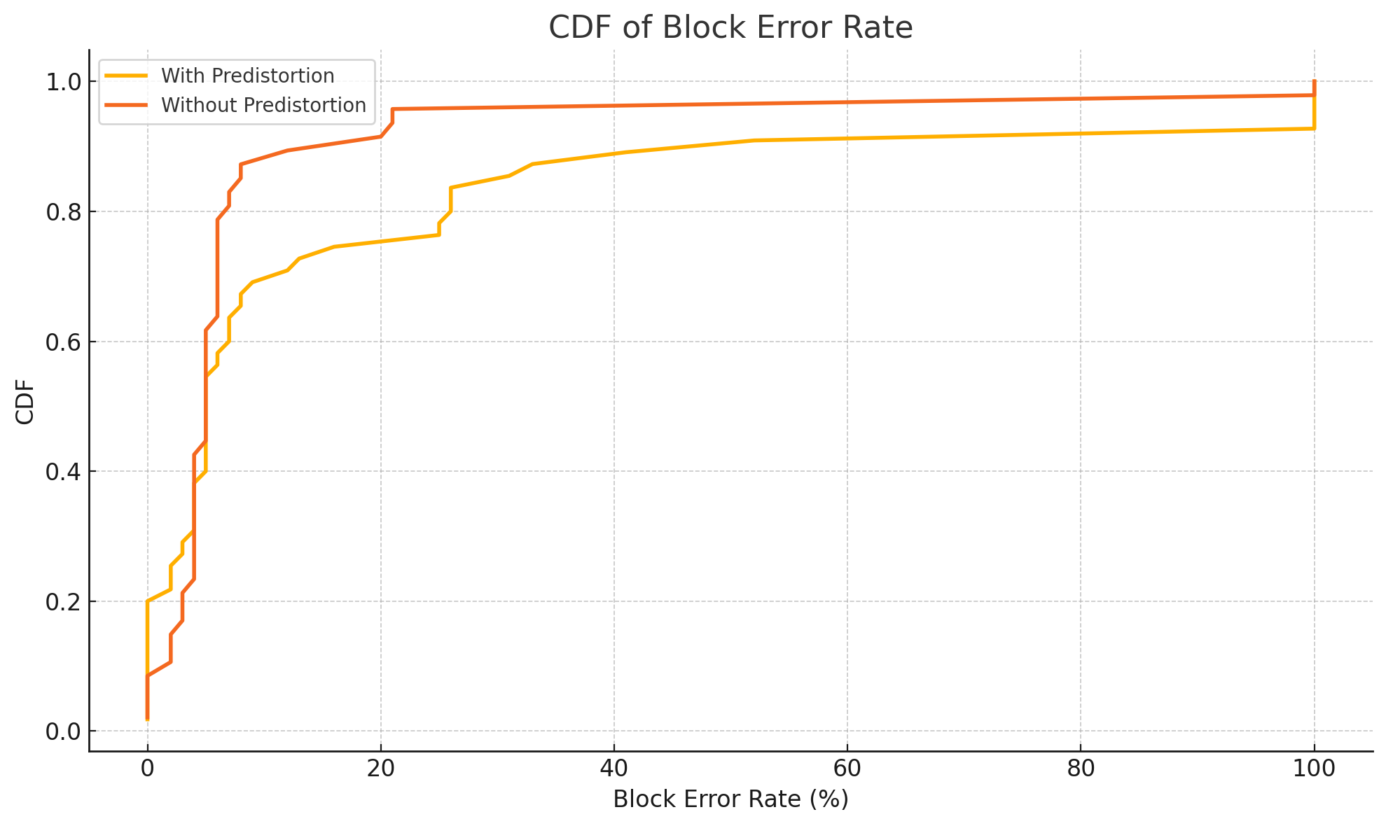
Non-fixed CQI

Slide 20
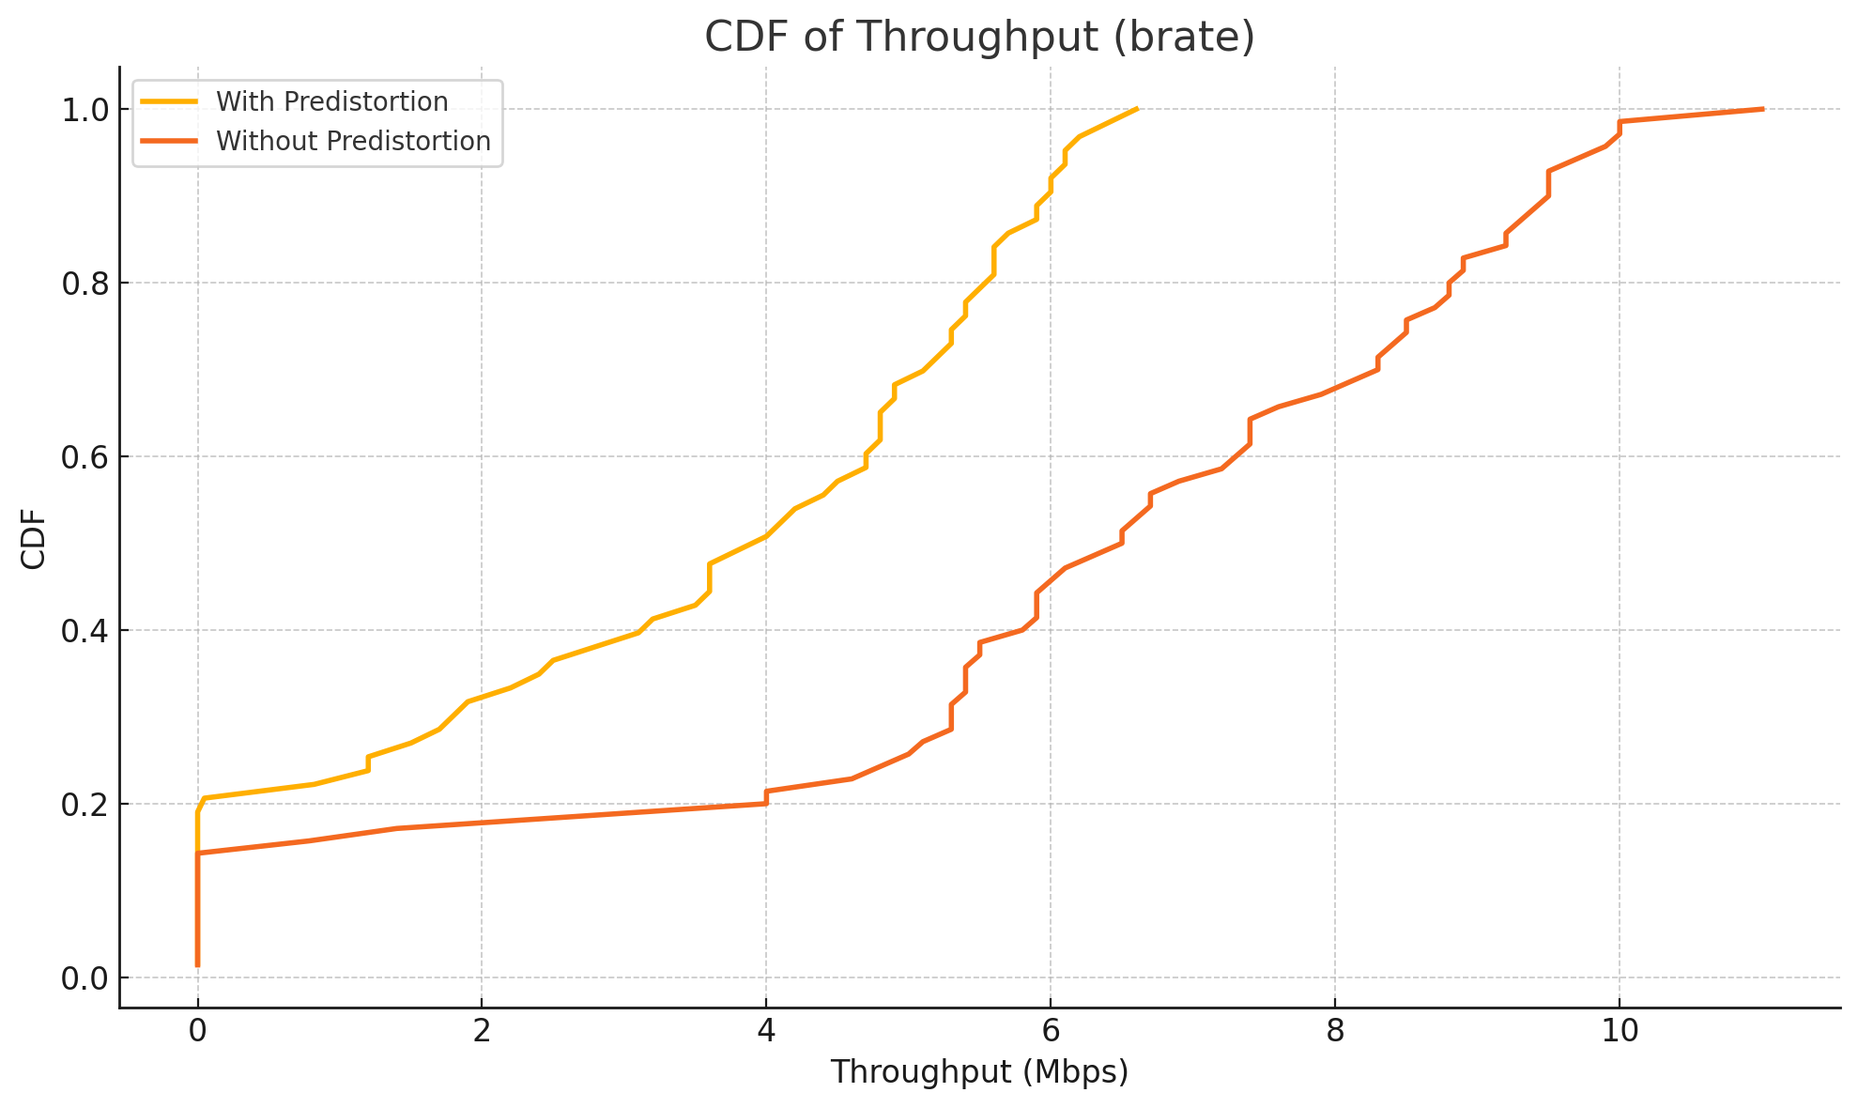

Slide 21
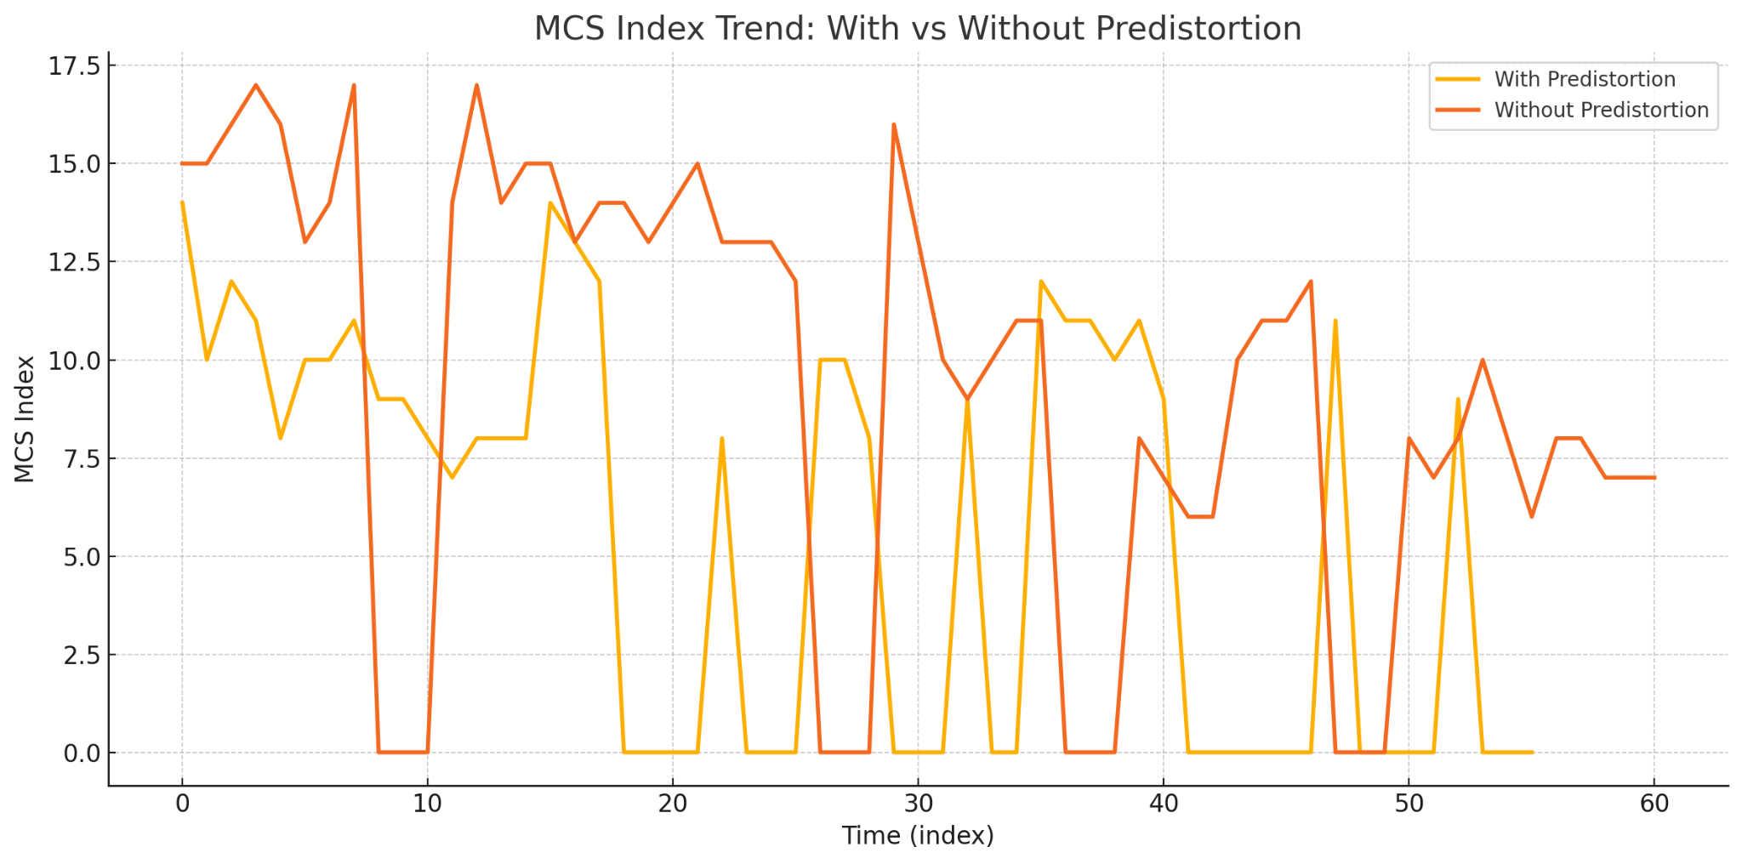

Slide 22
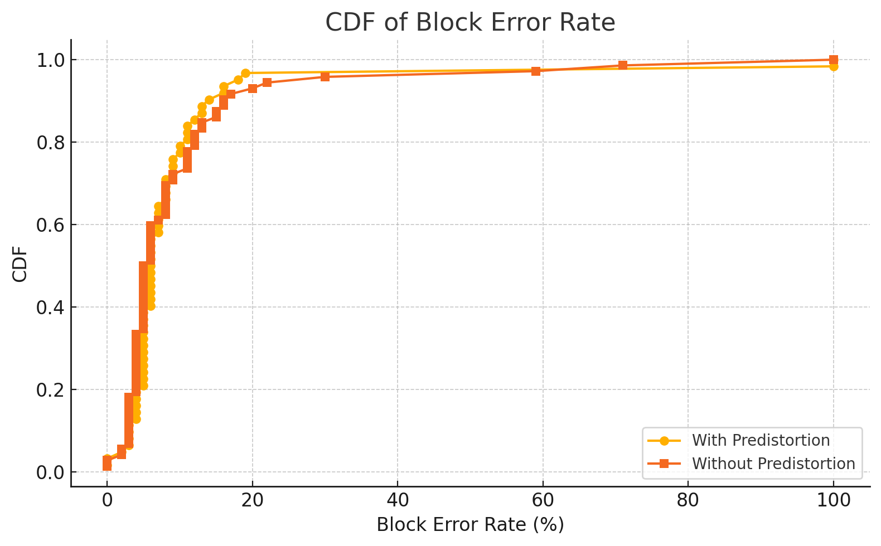
Non-fixed MCS Test 2 due to previous differences between MCS are too much

Slide 23
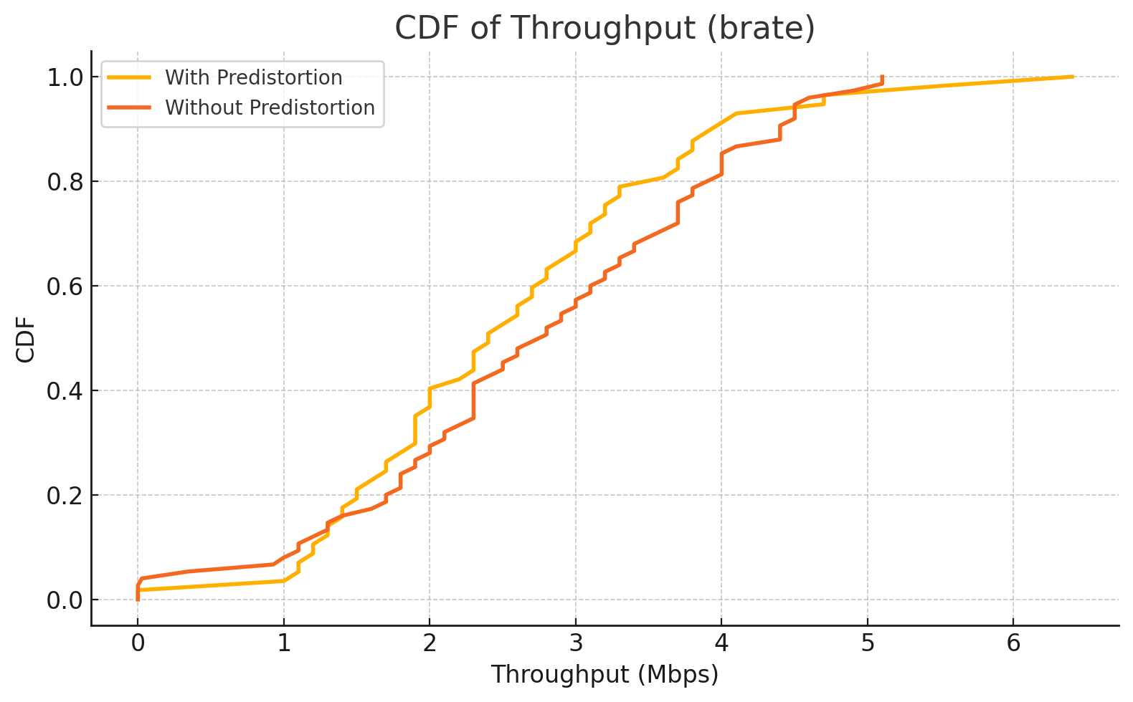

Slide 24
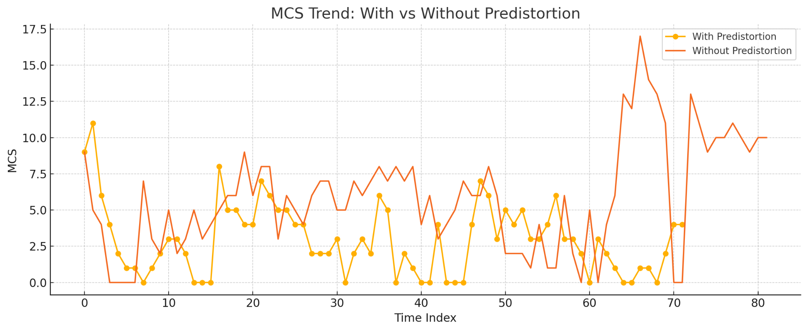

Slide 25
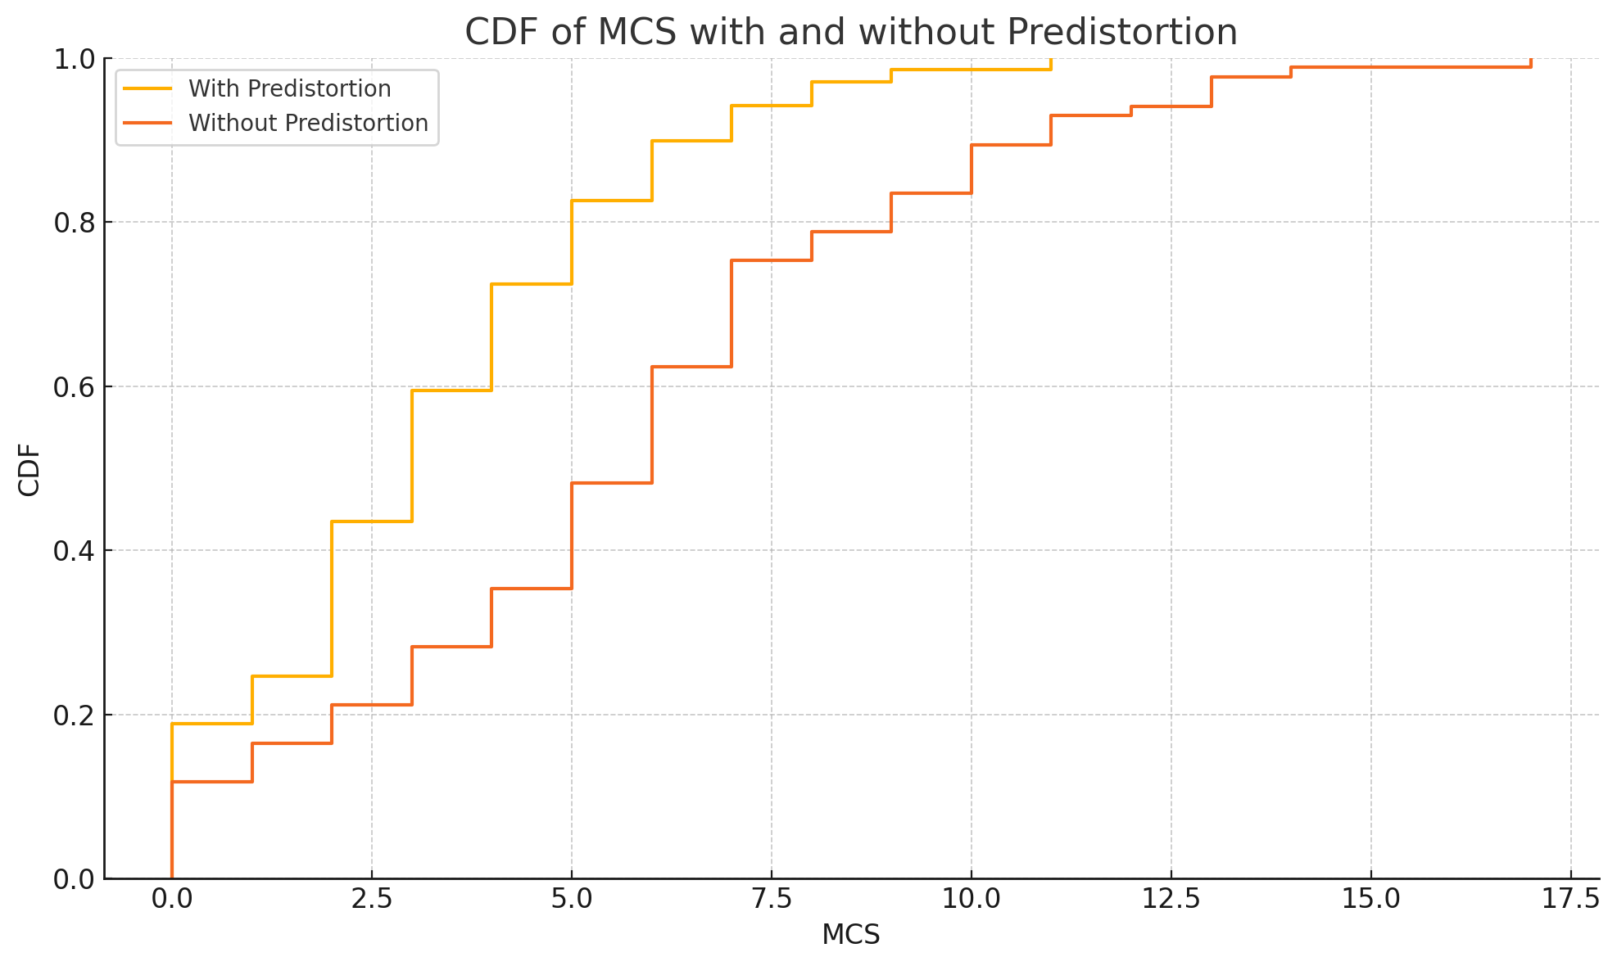

Slide 26
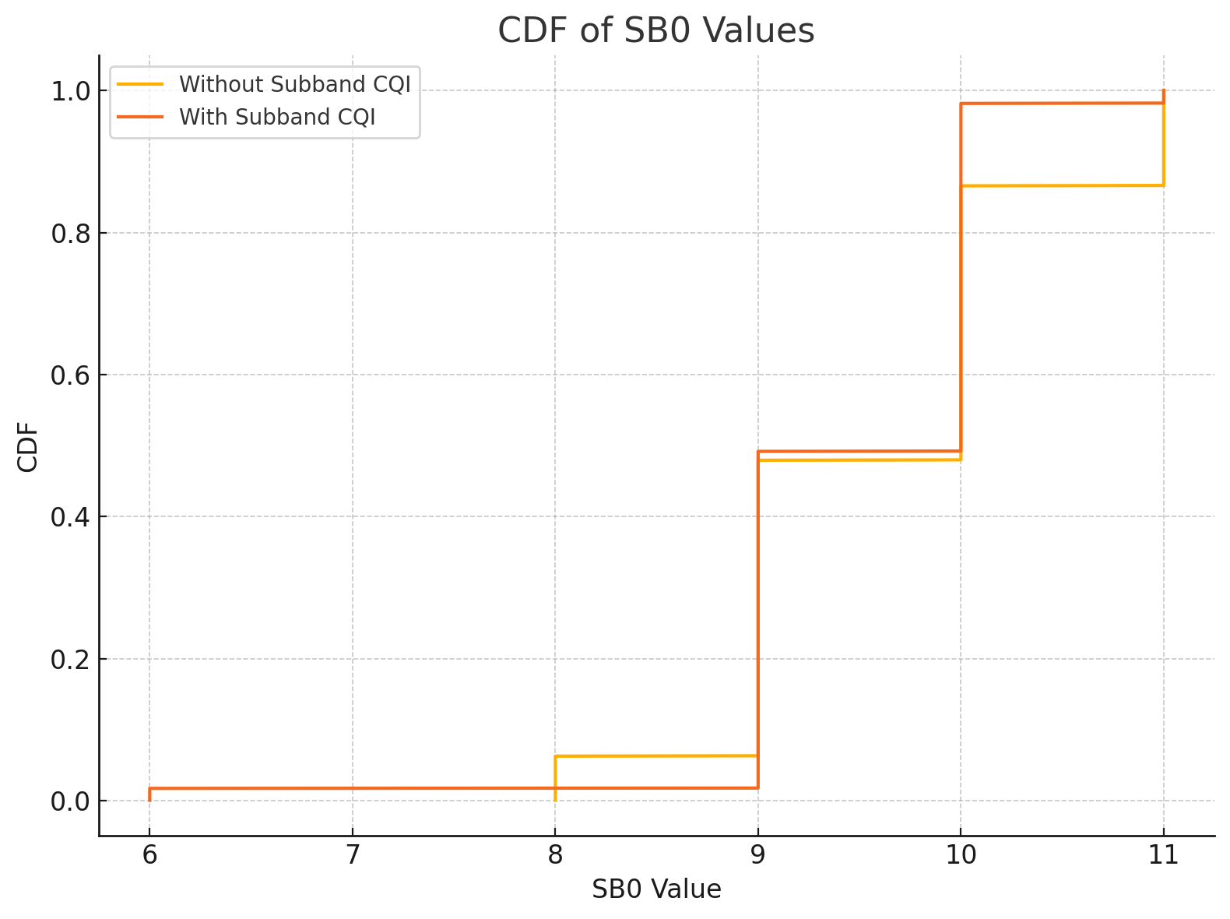

Slide 27
06/20/2025
To do:
Store UE’s subband CQI compare w Enb.
Block the devices physically

Slide 28
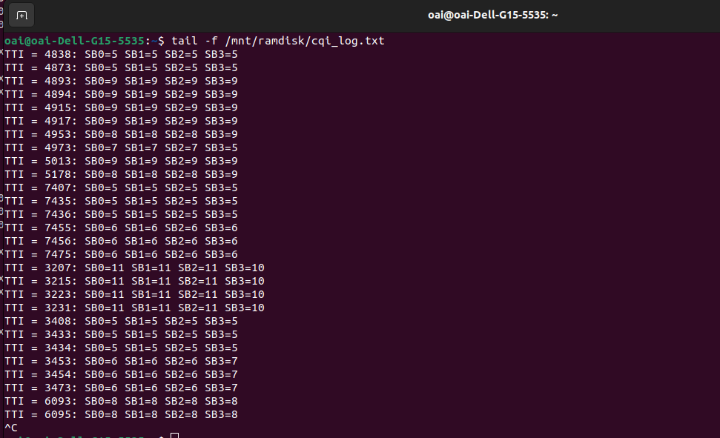
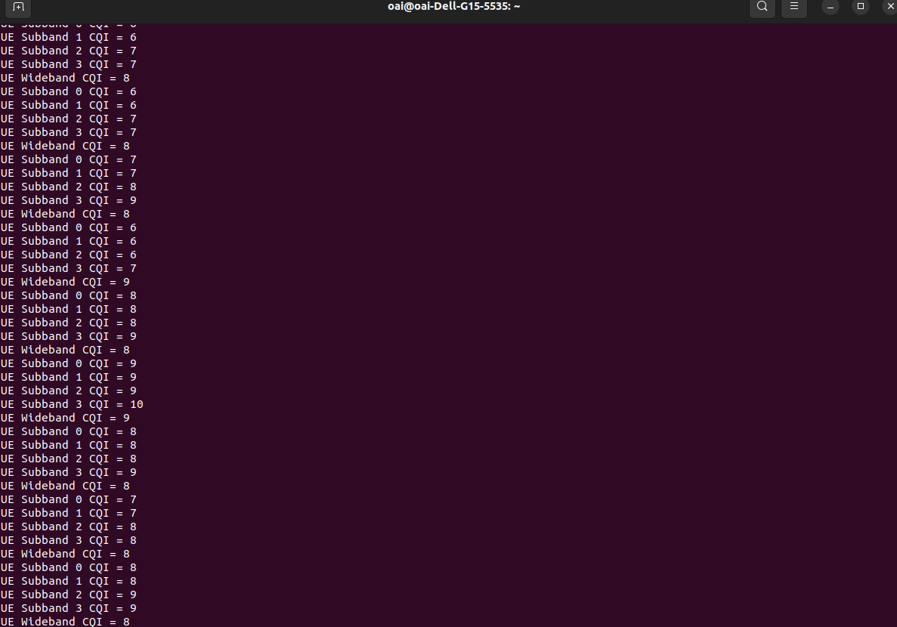
Subband CQI comparison
Enb
UE

Slide 29
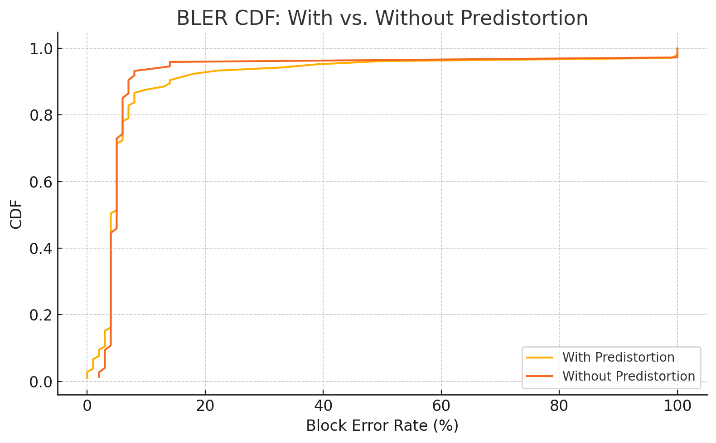
Non-fixed MCS

Slide 30
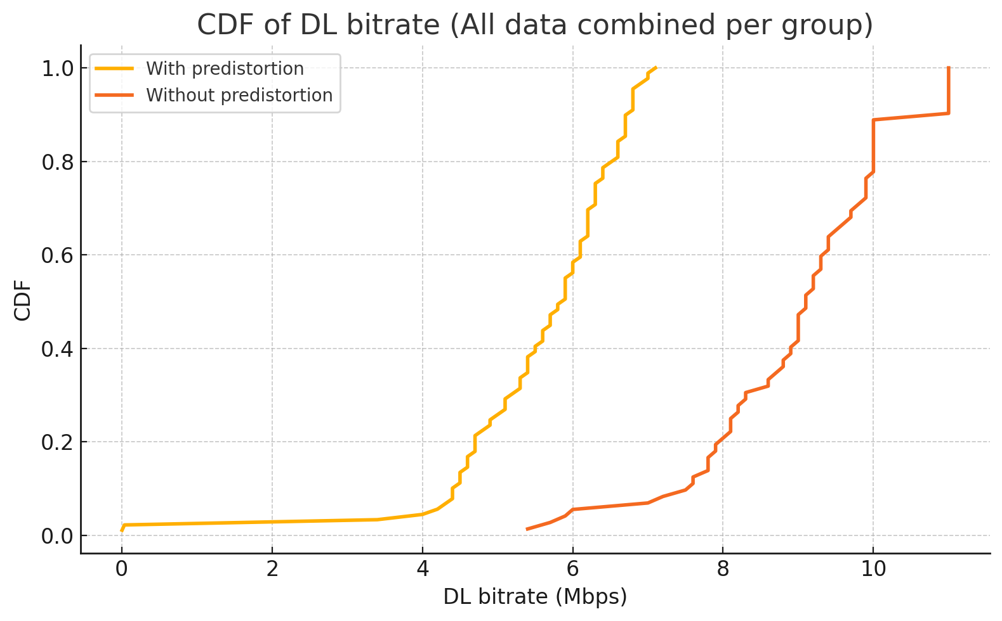

Slide 31
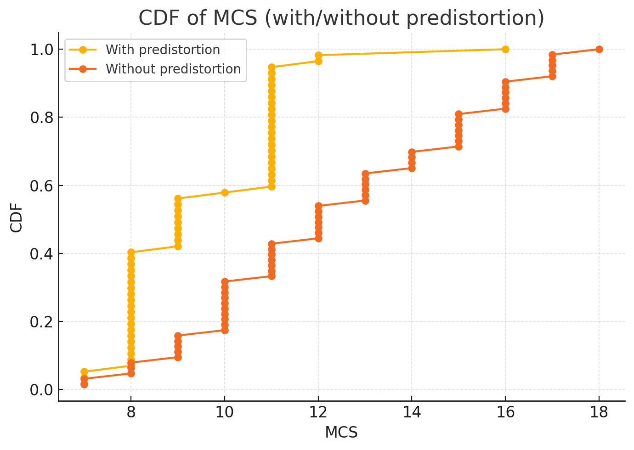

Slide 32
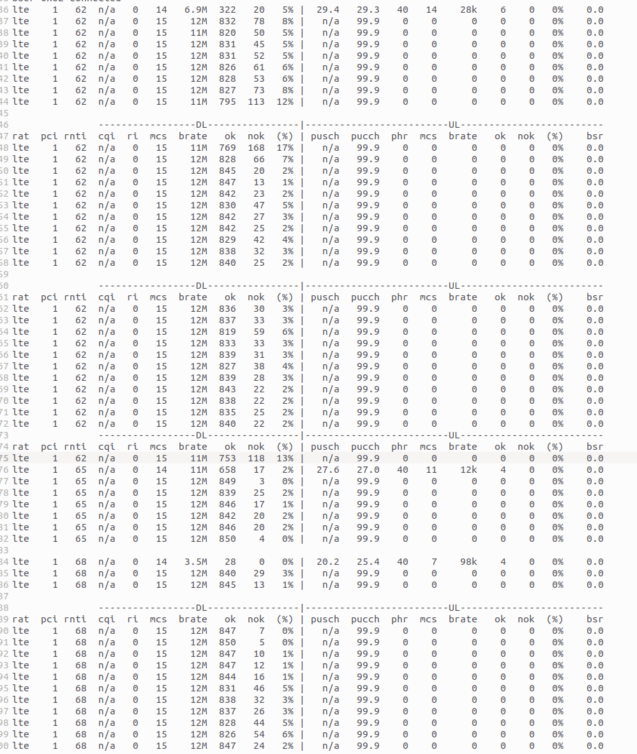
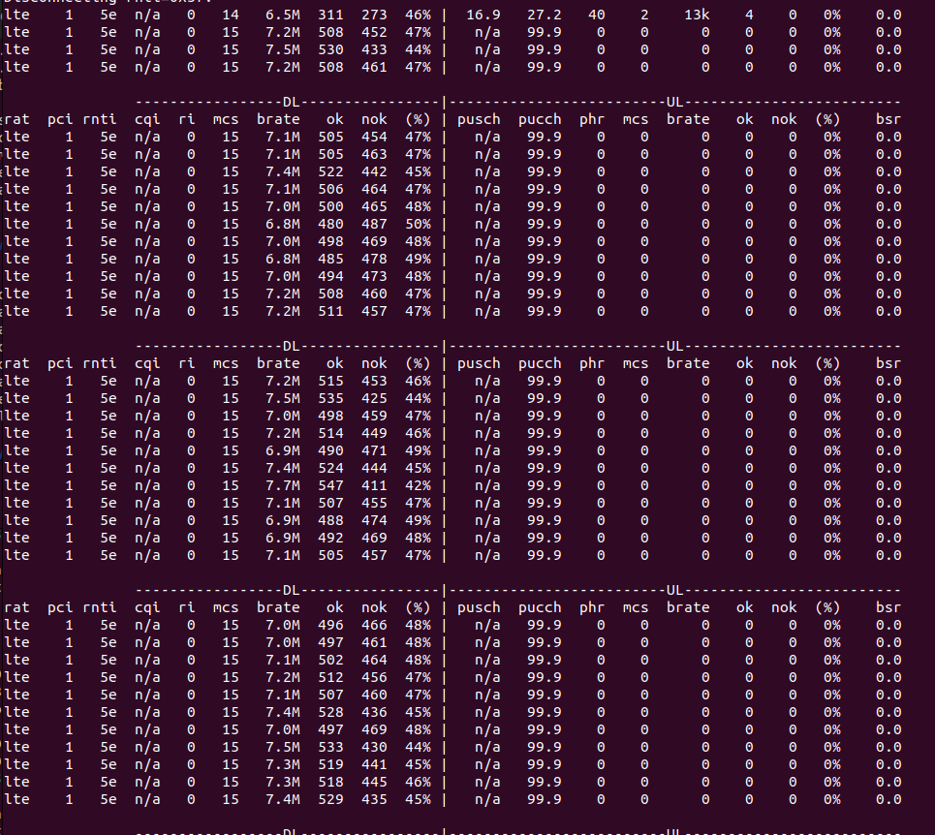
Fixed MCS=15
Without predistortion
With predistortion

Slide 33
06/30/2025
Problem: MCS is pretty low with pre-distortion enabled.
Possible issues:
1. The Algorithm is buggy or allocates less power. Even for same MCS we get half the brate and bler goes to 45% instead of 4-6 %
2. Latency is the main issue. Large latency means packet are getting dropped. Lower Bler for fixed MCS. For flex MCS, Bler is not low because channel is good. But, packet are still retransmitted and so the MCS is chosen smaller.
Ideas:
1. Try at fixed MCS of 5 and 10 (smaller value for both cases)
2. Try at lower bandwidth?
3. Try to optimize code for latency.
4. Try not saving cqi etc data to file memory (ramdisk) when doing end-end testing. Keep code bare minimum to essential blocks.
5. Try using system time recording to check latency of extra code, if it is more than 100us, it could be an issue.
6. Try forcefully setting subband relative cqi to 0 to rule out any algorithmic (power allocation) variations. Compare this case with your current two cases (with and without predistortion).

Slide 34
Modified code based on the above suggestions
1. Stopped saving Subband CQI in any form including ramdisk

Slide 35
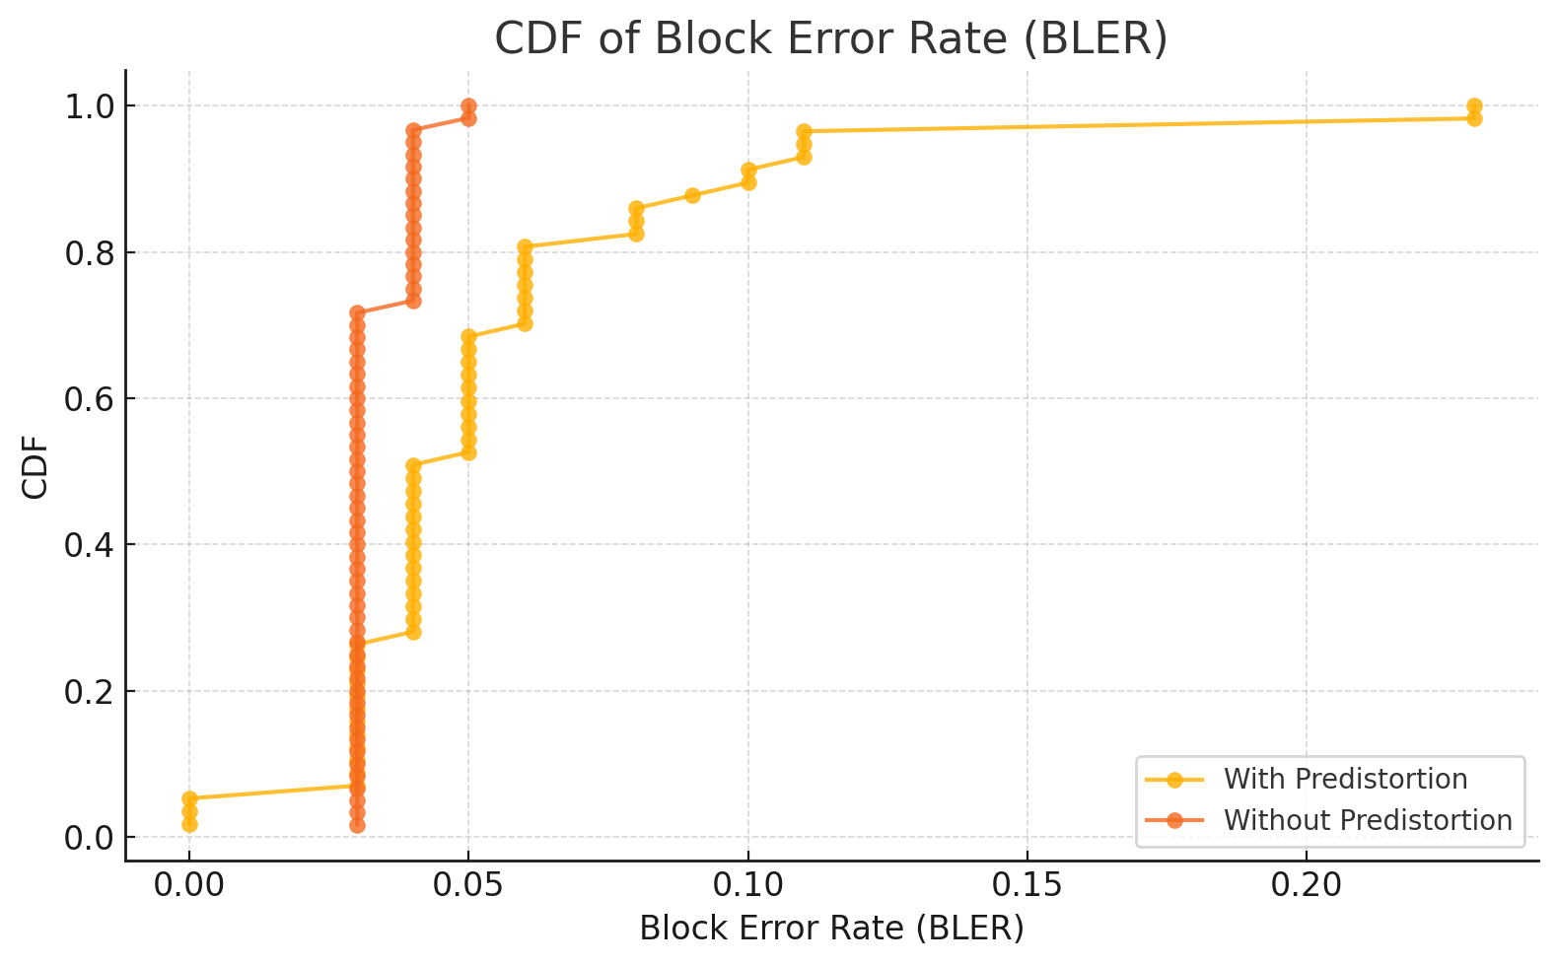
Fixed MCS=11

Slide 36
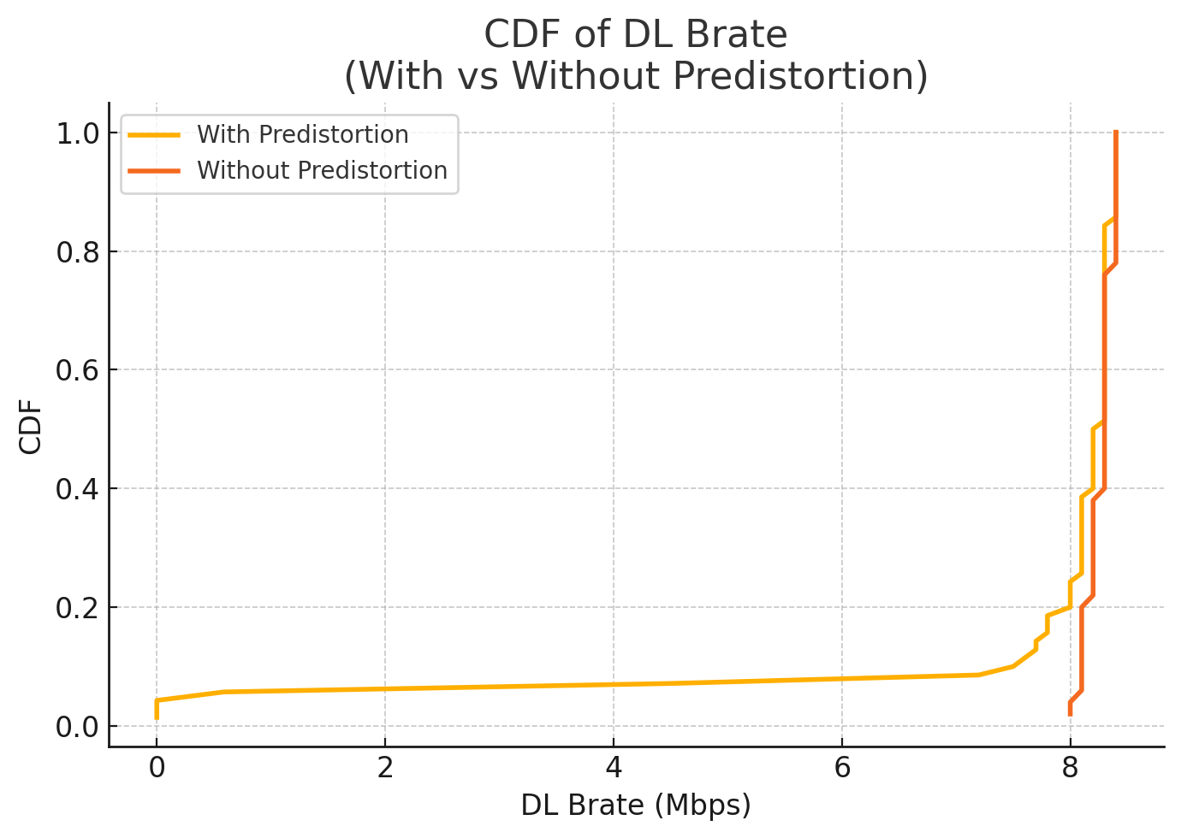

Slide 37
Findings
Under MCS=11, predistortion still leads to worse performance, next need to see the result of forcing all subband cqi to be the same value

Slide 38
Modified code based on the above suggestions
2. Forcing Subband CQI’s Diff Value to 0 on UE’s side, so that all subband cqi will have the same value which is wideband cqi

Slide 39
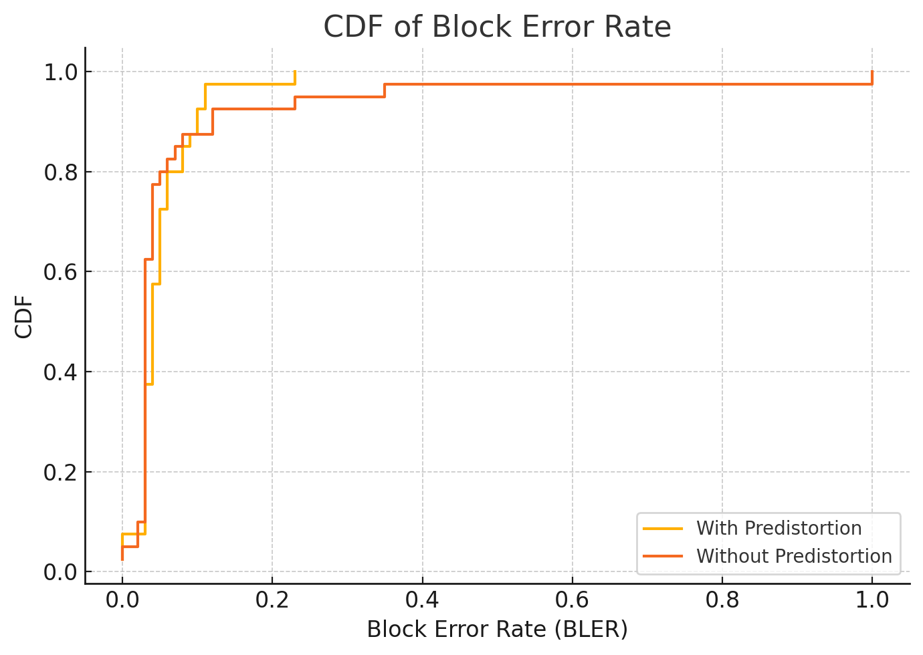
Fixed MCS=11

Slide 40
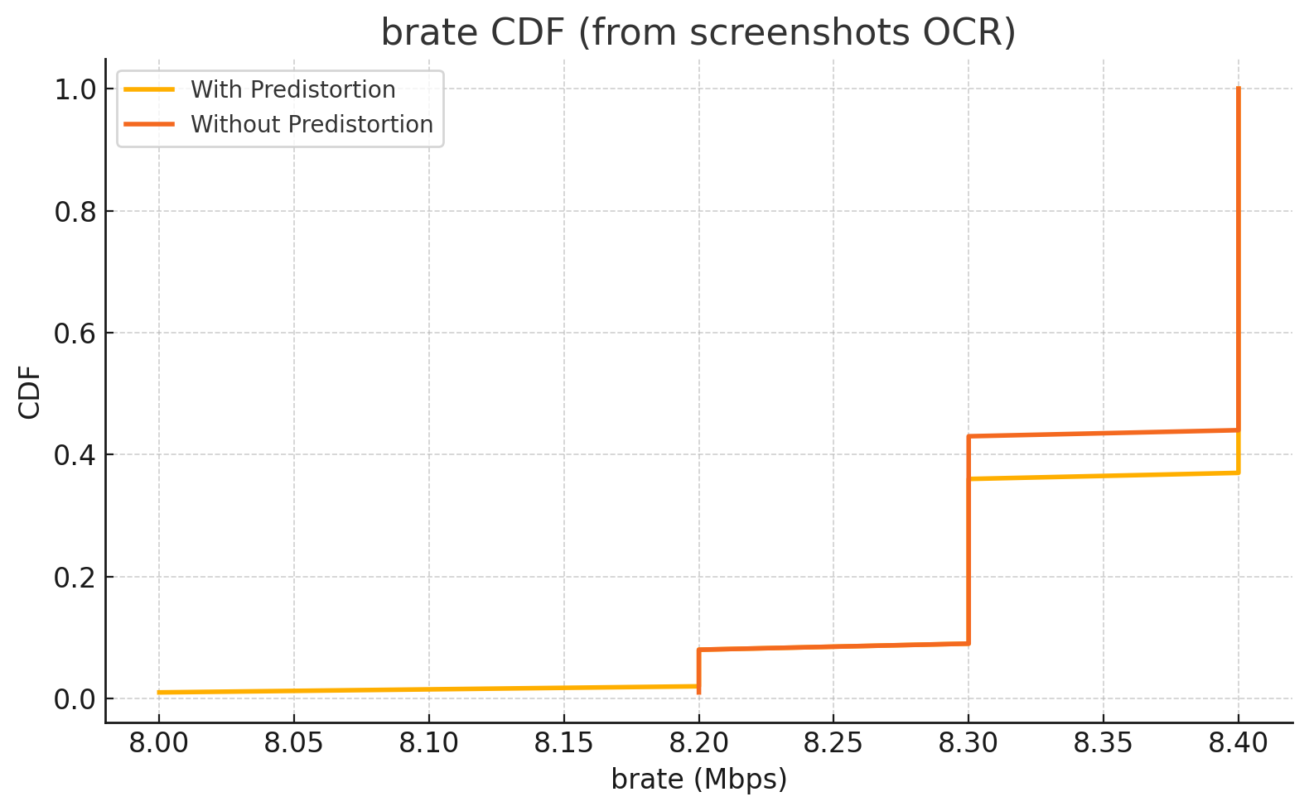

Slide 41
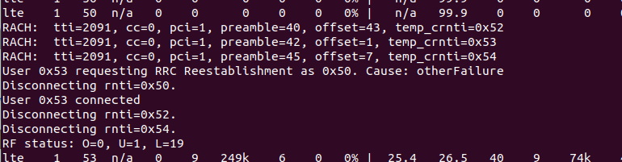
Findings
After forcing all subband cqi to the same, the performances seem to be more identical which is expected since power allocation should remain the same as without predistortion under this situation. However, during experiment, noticed that after opening predistortion, device tends to disconnect more often than without predistortion.

Slide 42
Potential causes
Inaccuracies and CQI Underestimation: If the predistortion is based on outdated or coarse feedback (e.g., subband CQIs from an earlier time, or only averaged per RBG), it might mis-estimate the needed compensation. The channel can change in the interval between CQI reporting and data transmission. Any mismatch means some subbands might be over-boosted or under-boosted. Over-boosting a subband doesn’t help beyond a point (it just wastes power or creates peaks), and under-boosting means that subband still causes errors. The UE, seeing an inconsistent or unexpected signal profile, might err on the side of caution in subsequent CQI reports – effectively underestimating CQI because the link became less predictable. From the eNB’s perspective, if it starts getting fluctuating or lower CQIs (or if the HARQ NACK rate goes up), the logic will respond by choosing a lower MCS to ensure the target BLER is met.
HARQ Retransmissions and BLER Spike: A predistortion algorithm that isn’t perfectly calibrated can initially increase the BLER. For instance, if by flattening the spectrum the eNB removed some safety margin that existed on the strong subbands, any small noise on those frequencies could now cause errors where previously those subcarriers had power to spare. The first few transmissions with predistortion might see more decoding failures (HARQ NACKs) than the baseline case. Each NACK triggers the outer-loop to immediately reduce the MCS to try to re-attain the low target BLER. In other words, the system “learns” that with this new predistortion in effect, it must use a more robust MCS to avoid errors. The result is a lower steady-state MCS after adaptation. Essentially, the predistortion may have traded one kind of problem (frequency-selective fades) for another (e.g. higher overall interference or uncertainty), and the link adaptation compensates by backing off the rate.

Slide 43
Potential causes
In standard LTE (and srsRAN by default),
The UE estimates the channel via Reference Signals (RS).
These are pilot tones transmitted on known subcarriers with a known fixed power relative to the data.
UE uses the RS to compute SINR (per PRB or averaged), derives CQI, and sends that CQI back.
The eNB then chooses an MCS under the assumption that the power ratio between data symbols and RS symbols is fixed (defined via LTE P_A and P_B parameters).
Your custom predistortion breaks this assumption:
Your algorithm scales data on each subband differently (q->symbols[port][re_idx] /= amp[sb_idx]), but the RS is not scaled the same way (RS symbols were already inserted before pdsch.c).
That means, e.g., in subband 0 if you divide by amp[0]=2, the data gets halved, but the RS stays at original power.
When the UE demodulates, it sees the RS channel estimate H (from RS), but the data now has an amplitude mismatch.
This makes the equalization process invalid, effectively introducing post-equalization noise. The SINR after equalization drops, increasing error probability.
The UE then perceives “huh, the data is not as good as my RS predicted,” and will likely experience decoding failures.
This is one of the biggest sources of BLER increase and consequently why the HARQ will start firing more often, pushing the OLLA to lower the effective MCS.

Slide 44
07/02
Problem: Current predistortion will make eNB select lower MCS compared to the original set up while channel conditions are the same.
Possible issues:
Subband CQI accuracy needs to be further checked, and If dividing subband abandons some prb’s channel information
CRS’s slot info, how are CRS inserted into PRB/PDSCH?
Ideas:
Saving all prb’s channel estimate on UE’s side compared with 4 subband CQI in the same plot without predistortion
Double check SRSRAN 4g’s algorithm about how to select MCS

Slide 45
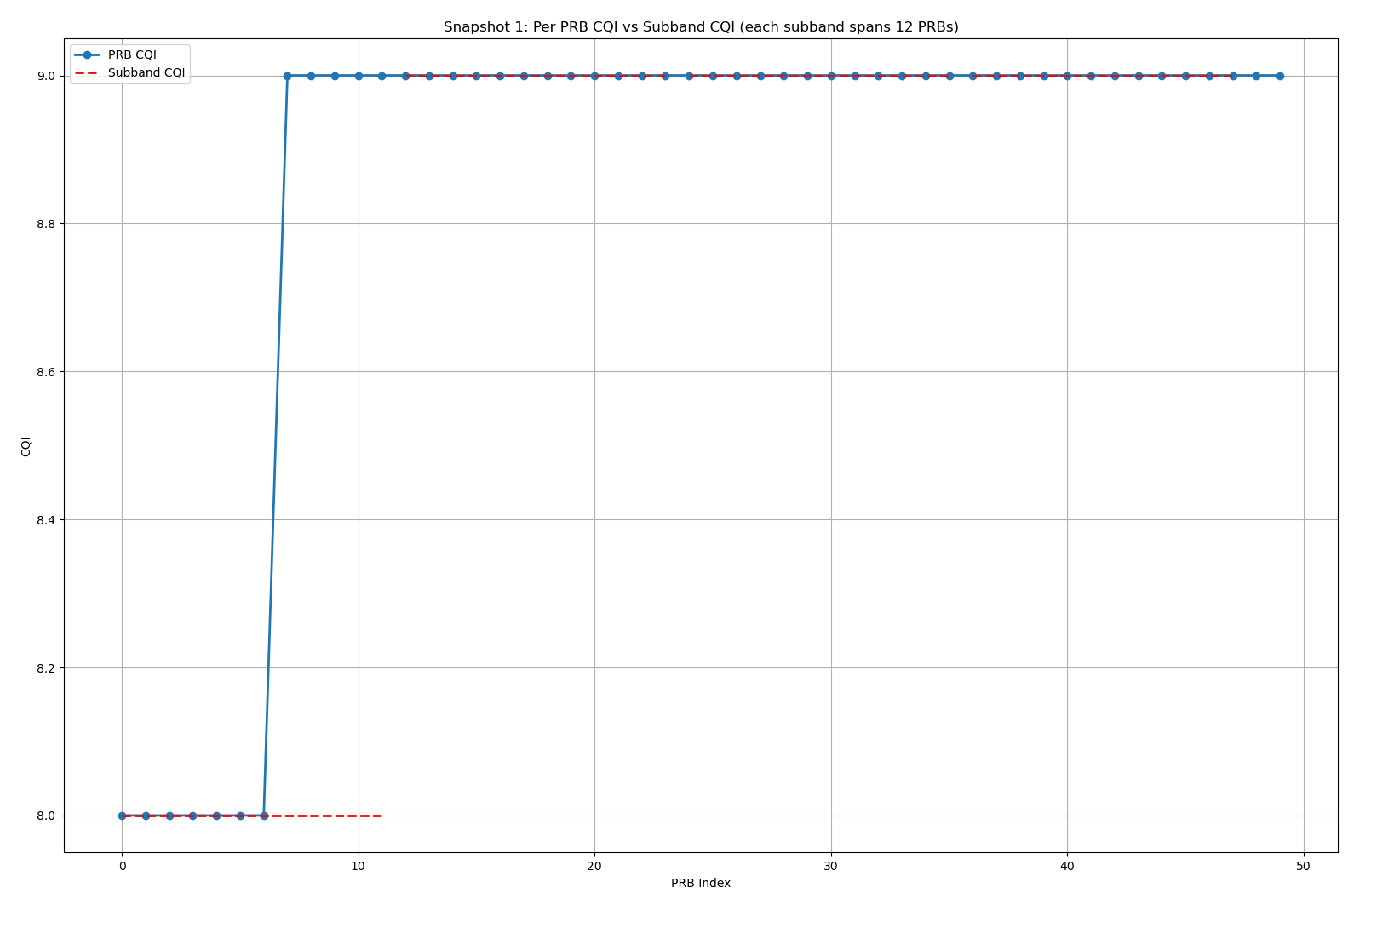
Subband Granularity Loss - 1

Slide 46
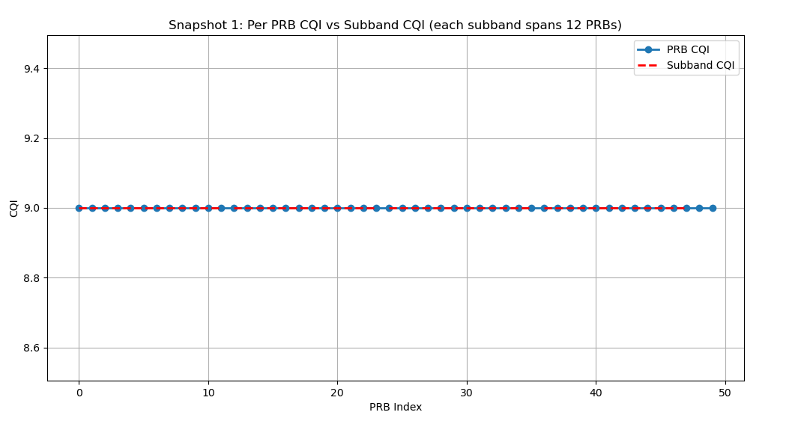
Subband Granularity Loss - 2

Slide 47
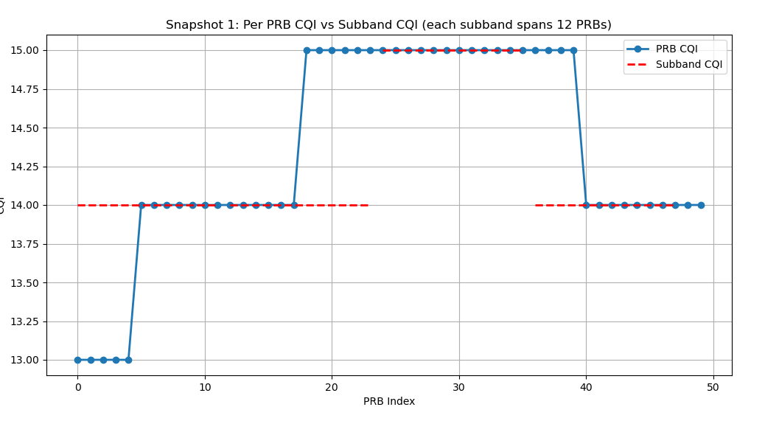
Subband Granularity Loss - 3

Slide 48
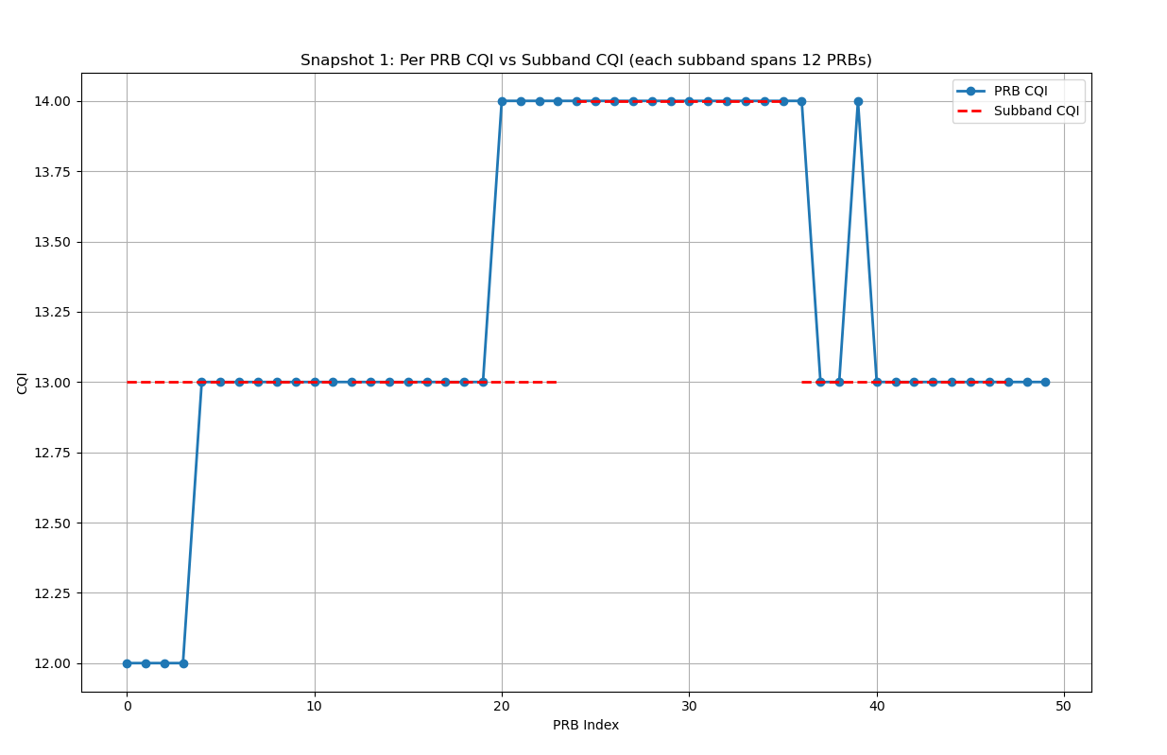
Subband Granularity Loss - 4

Slide 49
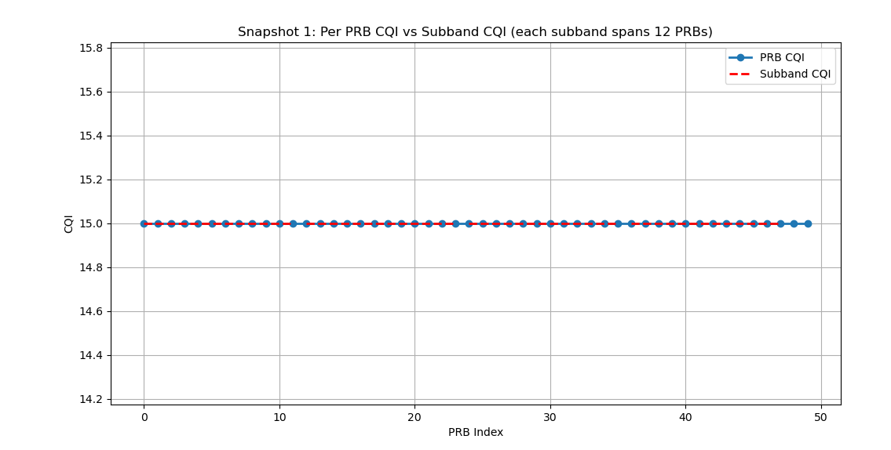
Subband Granularity Loss - 5

Slide 50
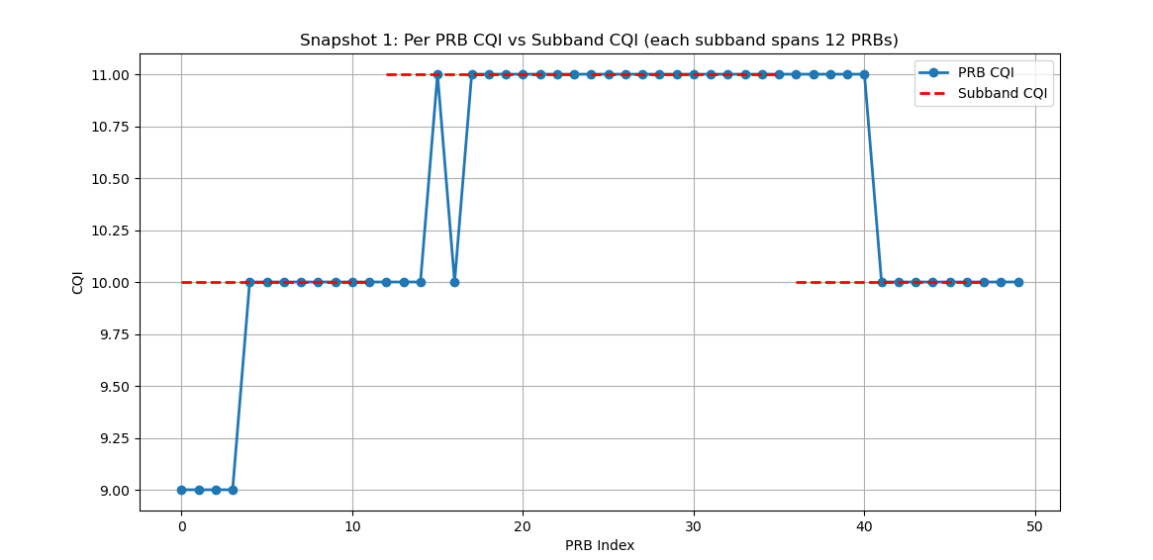
Subband Granularity Loss - 6

Slide 51
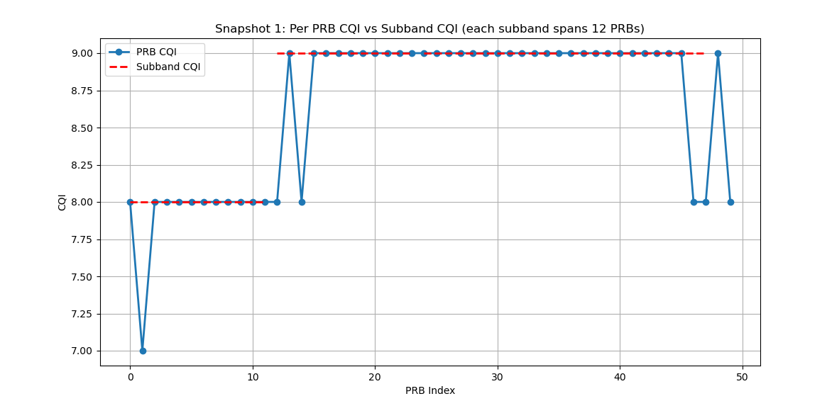
Subband Granularity Loss - 7

Slide 52
Subband Granularity Loss - 8

Slide 53
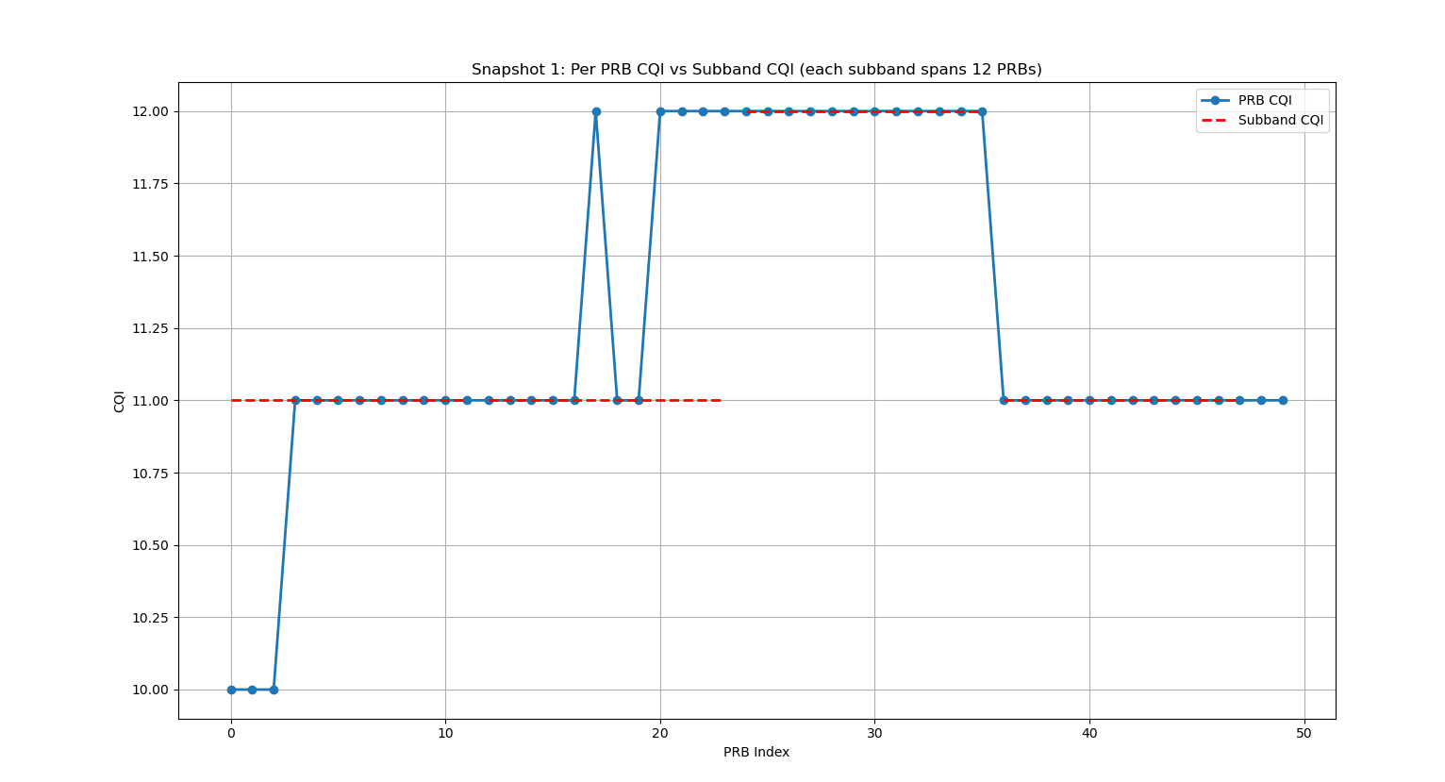
Subband Granularity Loss - 9

Slide 54
Outer Loop Link Adaptation (OLLA)
LLA turns the effective CQI up or down based on recent HARQ outcomes to maintain a target BLER.
If a UE keeps ACKing successfully, the eNB can gradually increase the CQI offset to try higher MCS;
if the UE had some NACKs (packet errors), OLLA will subtract an offset from the reported CQI to choose a slightly lower MCS next time
This explains why in the previous slides, we can see the block error rate between turning on/off predistortion are similar, while throughput have significantly differences

Slide 55
07/11
Problem: Based on current observations and all the discussions, we can confirm that Predistortion is causing much more retransmissions than the original setup. And this is the reason why we cannot see improvement when applying it.
Possible issues:
Need to double check if DMRS is pre-distorted
Synchronization issue because we currently do not have external clock
Subband CQI feedback to Enb is still not accurate. Only subband 3 is different than others
Ideas:
Double check DMRS mapping and make sure it is before pre-distortion
Buy a GPS disciplined oscillator if possible to make the system more stable

Slide 56
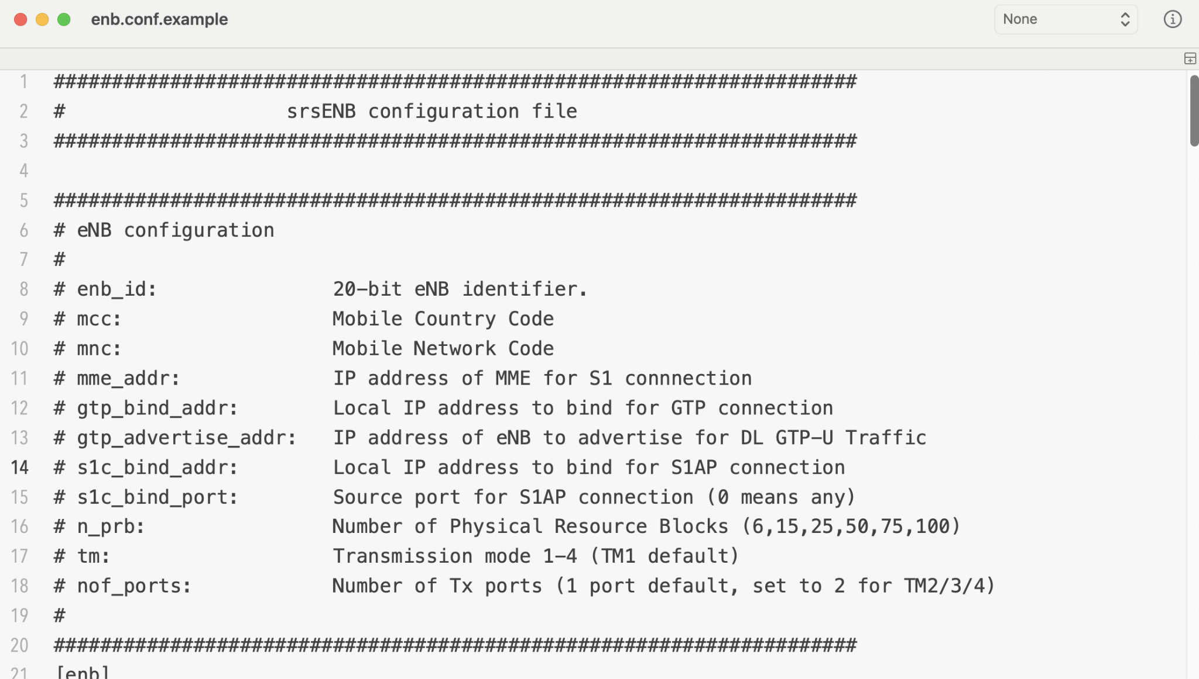
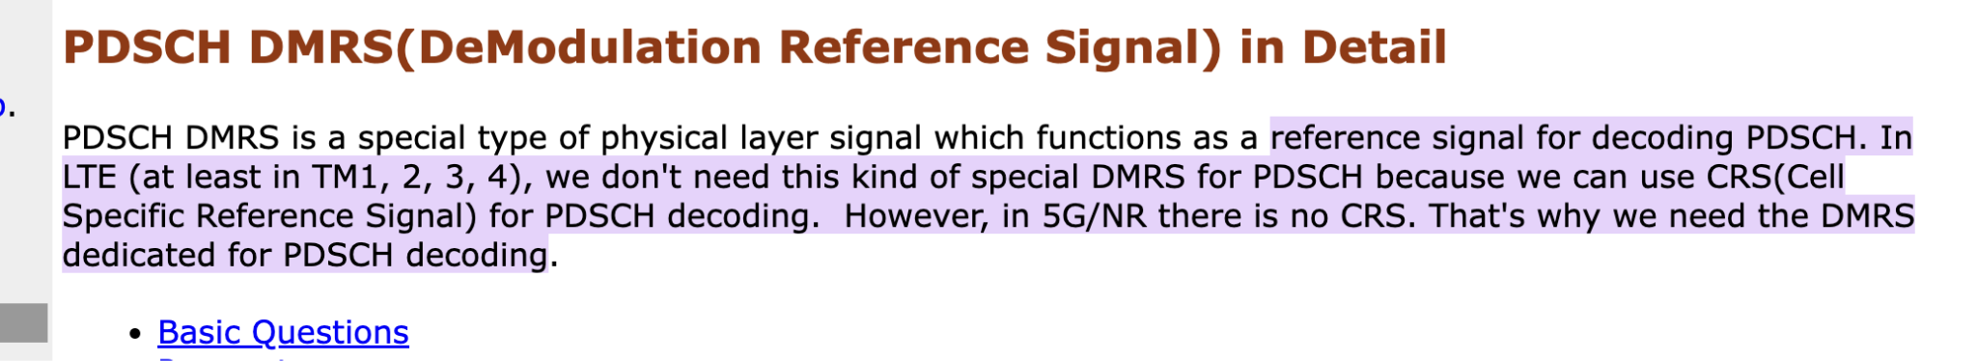
In srsran, the default transmission mode is TM1. According to the standard, TM1 only use CRS for channel estimate instead of DMRS. Thus, the following results are from applying predistortion to CRS signal.

Slide 57
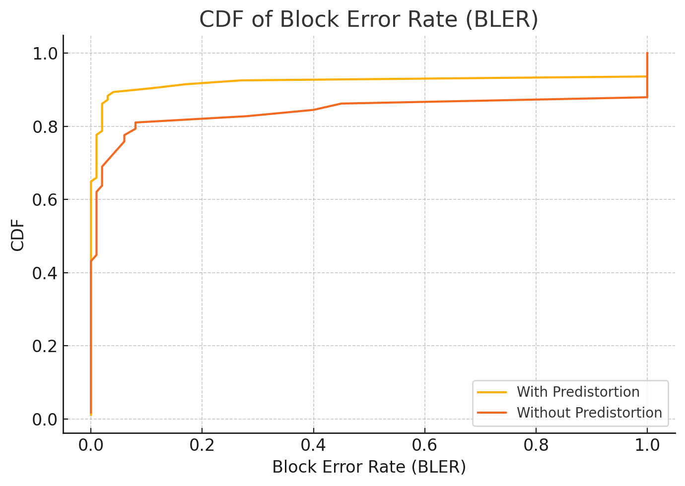
Fixed MCS=11

Slide 58
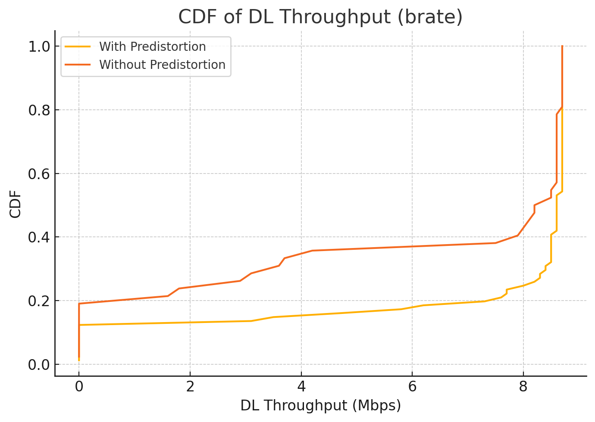

Slide 59
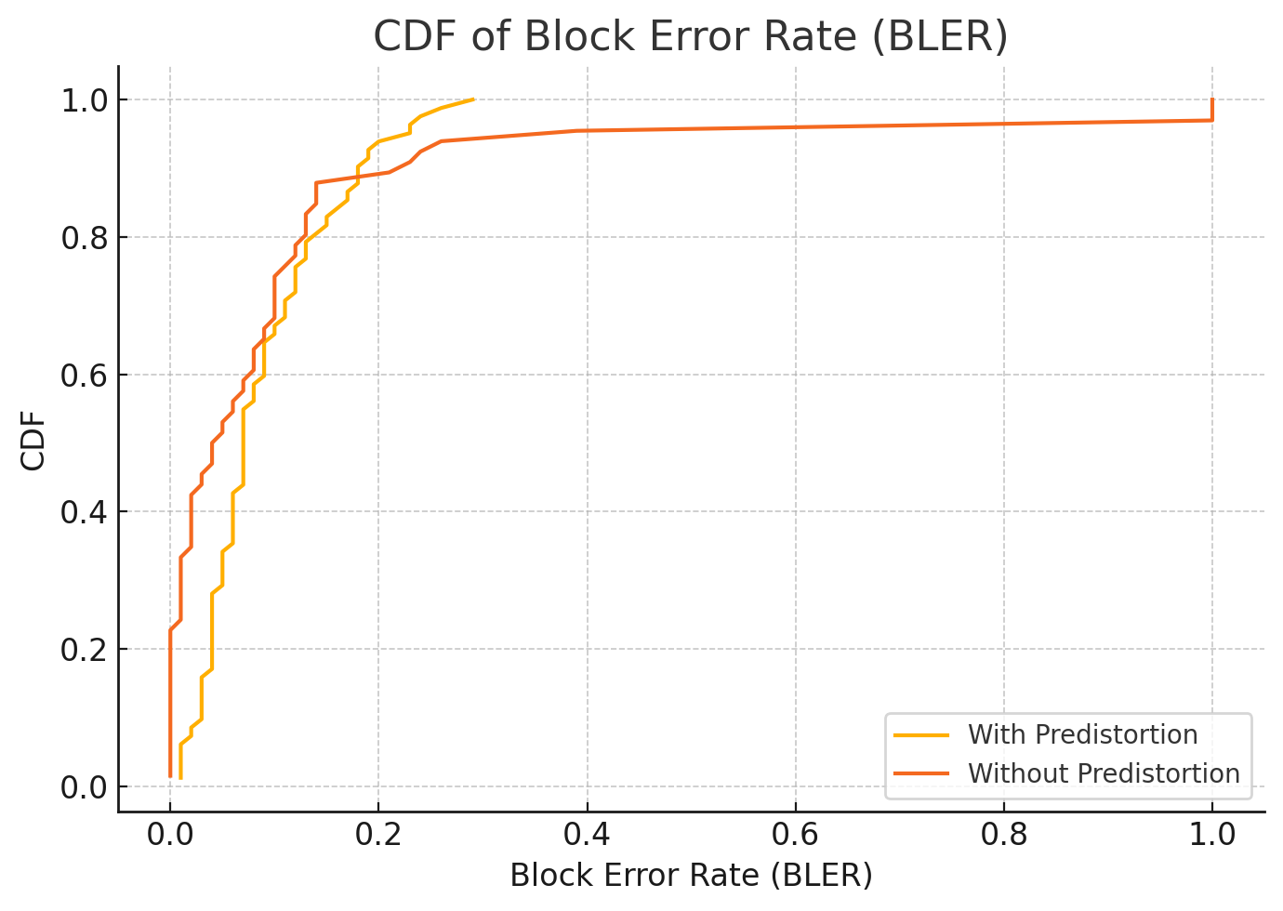
Fixed MCS=13

Slide 60


Slide 61

Fixed MCS=15

Slide 62


Slide 63
Observation
Predistortion is working from the results. Under the same channel condition, higher MCS could be applied.

Slide 64
07/18
Todo:
Different locations; static use fixed MCS not including rate control first; one location has 3 or 4 mcs values.
Summarize the predistortion Algorithm, background in 5g/4g about predistortion then simulation results for paper
Infocom is due on 7/30

Slide 65
LTE subband
Simulation
Discussion abt 5G

Slide 66
09/05
Traditional Adaptive Modulation and Coding (AMC)
Inner Loop LA: CQI only
Outer Loop LA, OLLA: HARQ+CQI (srsRAN uses) some work are focusing improving the step size for compensating the SINR

Slide 67
ML-Based
ML to estimate the channel
ML to select MCS
ML to compensate the delay brought by CQI reporting

Slide 68
Physical layer Collaboration
Extend MCS selection to MCS+power allocation selection
Subband-level MCS/multiple PDCCH

